Slide 1
Let’s Talk… Care homes/Home care

Slide 2
Ground Rules
If we lose you during the session or you have wifi connection issues, please rejoin the meeting, following the same link/meeting ID and password.
To limit background noise, please keep your microphone off unless speaking.
This is an information giving session, rather than a clinical advice session.
Any questions for our guest speakers should be asked at the end of their session, during the Q&A section.
Please use the chat or raise your hand to connect with our guest
……. And lastly ..…..
Please be respectful to each other and each others opinions.
Thank you for attending and we hope you enjoy the session.

Slide 3
Today’s Programme
Nigel Bonser - Citizens Advice Rotherham
Benefits for those in care
Support available
How to contact the service
Barbara - Rotherham Older Peoples Fourm
Direct Payments
Michelle Stevens - Kinetic Nursing Services
What is Kinetic Nursing
Key benefits of the role for staff and clients
Challenges of the role
Hopes for the future
How to contact the service
Jayne Lowe - Rotherham Hospice
About Rotherham Hospice
Impatient Unit
Community Team
Day Hospice
Any other Business and August ‘Let’s Talk’ Event Details
Let’s get to know each other...
What is your name and where are you from? (Add it to the chat box)
Hannah Dutton - The Purple Butterfly Service
About the new service
How it will support
How to contact if interested
Jules and Chris - Broadacres Care home
About Broadacres
The care it provides/what support clients receive
A typical day
How to contact the service

Slide 4
Nigel Bonser - Citizens Advice Rotherham

Slide 5
Q&A

Slide 6
DIRECT PAYMENTS
Barbara Booton

Slide 7
DEFINITION
Direct Payment
Money paid to you (or an authorised person) by your council so that you can arrange your own care and support

Slide 8
BACKGROUND TO DIRECT PAYMENTS
2014
Care Act
2009
DP regulations
2003
Duty to provide
1997
LA’s given power to make

Slide 9
ADVANTAGES
Puts you in control of how you commission your own care and support.
Gives you more choice, control and independence.
Support of your choice, at times and in ways to suit you.
Reduces administrative costs and can make your personal budget go further.

Slide 10
BARRIERS & CHALLENGES
Lack of clear information including insufficient information about what payments can be used for
Problems in recruiting, employing, retaining and developing PAs
Perceived complexity of managing direct payments
Concerns around managing financial aspects
Confusion over the self-assessment process
Effort required organising support especially for smaller packages
Inadequately funded package, making option unattractive
Lack of targeted information, advice and support for traditionally excluded and marginalised groups
Insufficient outreach, particularly to under-represented groups
Mismatch between the hourly rates used for Direct payments, and the recruitment of suitable staff to meet people’s different needs

Slide 11
USEFUL RESOURCES
Active Independence
Online courses, knowledge base, PA Register
Www.activeindependence.org
Skills for Care
Learning and development hubs for individual employers and PAs
Www.skillsforcare.org.uk
TLAP
Research and information
Www.thinklocalactpersonal.org.uk
Gov Website
Employer responsibilities
www.gov.uk

Slide 12
Q&A

Slide 13
Michelle Stevens - Kinetic Nursing Services Rotherham

Slide 14
Q&A

Slide 15
Rotherham Hospice
Jayne Lowe
Notes:
Quiz next on Handout – discussion about this

Slide 16
About me
Notes:
Quiz next on Handout – discussion about this

Slide 17
I have 24 years of Nursing experience, caring for a diverse range of patients in a number of different roles – over 6 of these in leadership roles within the Emergency Department, Palliative Care Unit and Acute and Same Day Emergency Care.
My previous Roles are Clinical Support Worker, Ward Clerk and Clinical Technician in Acute Medicine & Plastics and Burns. Staff Nurse and Sister in an Emergency Department, Ward Manager on a Palliative care unit and Matron in Acute Medicine
I have been in my Role at Rotherham Hospice since July as Deputy Director of Clinical Services
Notes:
Quiz next on Handout – discussion about this

Slide 18
Impatient Unit
Notes:
Quiz next on Handout – discussion about this

Slide 19
Our purpose-built, 14 bed Inpatient Unit offers expert care and attention 24 hours a day, 7 days a week. While our services are provided free of charge to patients and their families, we are an independent charity, and not NHS funded.
All 14 single rooms have ensuite facilities in the Hospice which have been furnished and equipped to an extremely high standard. This allows our patients to receive care within a homely setting where the focus is placed on the patient, not the illness.
Notes:
Quiz next on Handout – discussion about this

Slide 20
Community Team
Notes:
Quiz next on Handout – discussion about this

Slide 21
Rotherham Hospice community team aims to support patients in their usual place of residence. This can be their home, care home, or family members’ home. The team is made up of Clinical Nurse Specialists, Palliative Care Nurses, Healthcare Support Workers, Physiotherapists, Occupational therapists, and volunteers. The hospice community team work alongside other community services, such as GPs, District Nurses, and other agencies, to best support a patient and those important to them.
The Hospice at Home team provide a responsive service to patients in Rotherham. Providing symptom management, support for future planning and end of life care. The team has a 24/7 advice-line for patients, families and professionals, to access advice and discuss visits.
Notes:
Quiz next on Handout – discussion about this

Slide 22
Day Hospice
Notes:
Quiz next on Handout – discussion about this

Slide 23
Managing symptoms such as pain, sickness and fatigue
Adapting to difficult situations, address anxiety or emotional support
Offer advice regarding practical and financial issues
Support in planning for the future
Emotional and psychological support
Access to complementary therapies and hairdressing
Opportunity to take part in creative and social activity
Notes:
Quiz next on Handout – discussion about this

Slide 24
Q&A

Slide 25
Hannah Dutton - The Purple Butterfly Service

Slide 26
Q&A

Slide 27
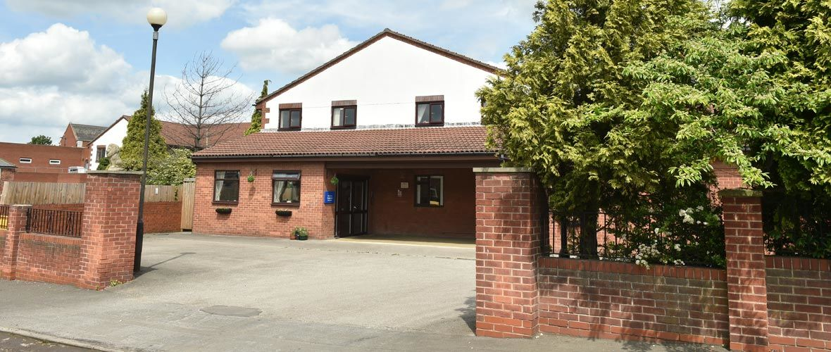
Jules and Chris - Broadacres Care home

Slide 28
Q&A

Slide 29
Feedback survey:
We would really appreciate some feedback from these ‘Let’s Talk’ sessions, so we can constantly improve.
Please take 5 minutes to fill out this short survey. All feedback will be anonymous. Thank you.
Survey link:
https://forms.gle/toE8Nr2mXMKJwPxv7
Notes:
https://forms.gle/toE8Nr2mXMKJwPxv7 - survey link

Slide 30
Upcoming Let’s Talk Event:
‘Let’s Talk… Loneliness’
Open to both the public and professionals
Wednesday 14th December :11am-12pm via Zoom

