Slide 1
Let’s Talk… Menopause

Slide 2
Ground Rules
If we lose you during the session or you have wifi connection issues, please rejoin the meeting, following the same link/meeting ID and password.
To limit background noise, please keep your microphone off unless speaking.
This is an information giving session, rather than a clinical advice session.
Any questions for our guest speakers should be asked at the end of their session, during the Q&A section.
Please use the chat or raise your hand to connect with our guest
……. And lastly ..…..
Please be respectful to each other and each others opinions.
Thank you for attending and we hope you enjoy the session.

Slide 3
Today’s Programme
Sony Sara George - Registered Nurse (Northern General hospital, Sheffield teaching hospital)
What is menopause
Signs and Symptoms
Lifestyle changes
Help and support
Jane Owen - Link worker
Menopause group
How the group supports people
How to contact the service
Other support available in Rotherham
Menopause experiences
Any other Business and February ‘Let’s Talk’ Event Details
Let’s get to know each other...
What is your name and where are you from? (Add it to the chat box)

Slide 4
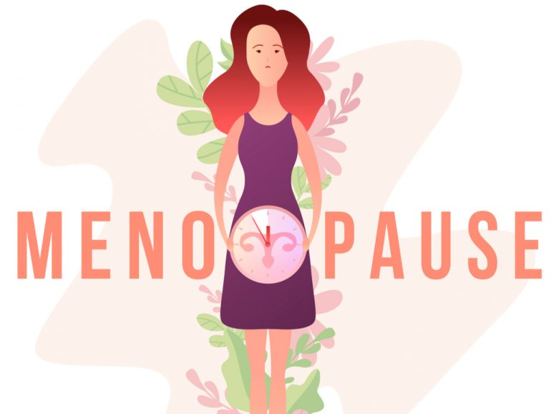
Image Credit :https://cbdlifemag.com/can-cbd-help-relieve-symptoms-of-menopause/<

Slide 5
Menopause: What and when is Menopause?
Menopause is when your periods stop due to lower hormone levels.
This usually happens between the ages of 45 and 55.
You reach menopause when you have not had a period for 12 months
Natural menopause takes place when the ovaries become unable to produce the hormones estrogen and progesterone.
Menopause can also occur when the ovaries are damaged by specific treatment such as chemotherapy or radiotherapy, or when the ovaries are removed, often at the time of a hysterectomy.
Content Credit: https://www.nhs.uk/conditions/menopause/

Slide 6
Menopause: What and when is Menopause?
Menopause is when your periods stop due to lower hormone levels.
This usually happens between the ages of 45 and 55.
You reach menopause when you have not had a period for 12 months
Natural menopause takes place when the ovaries become unable to produce the hormones estrogen and progesterone.
Menopause can also occur when the ovaries are damaged by specific treatment such as chemotherapy or radiotherapy, or when the ovaries are removed, often at the time of a hysterectomy.
Content Credit: https://www.nhs.uk/conditions/menopause/

Slide 7
Menopause: What and when is Menopause?
Menopause is when your periods stop due to lower hormone levels.
This usually happens between the ages of 45 and 55.
You reach menopause when you have not had a period for 12 months
Natural menopause takes place when the ovaries become unable to produce the hormones estrogen and progesterone.
Menopause can also occur when the ovaries are damaged by specific treatment such as chemotherapy or radiotherapy, or when the ovaries are removed, often at the time of a hysterectomy.
Content Credit: https://www.nhs.uk/conditions/menopause/

Slide 8
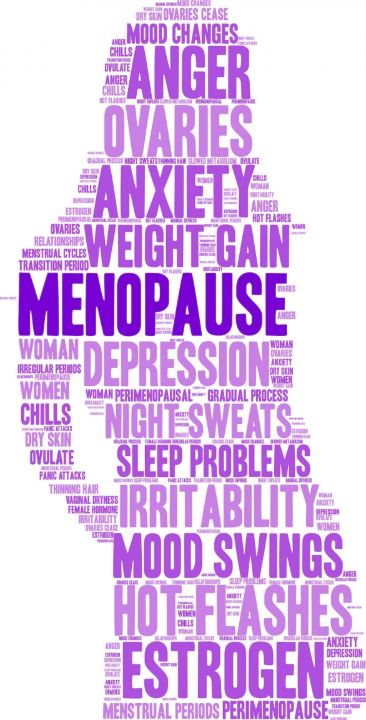
Why Menopause Matters!
Menopause and perimenopause can cause symptoms like anxiety, mood swings, brain fog, hot flushes and irregular periods.
These symptoms can start years before your periods stop and carry on afterwards.
Menopause and perimenopause symptoms can have a big impact on your life, including relationships and work.
Perimenopause is when you have symptoms before your periods have stopped.
Image credit: https://www.tysonsgynecology.com/the-truth-about-perimenopause-weight-gain/

Slide 9
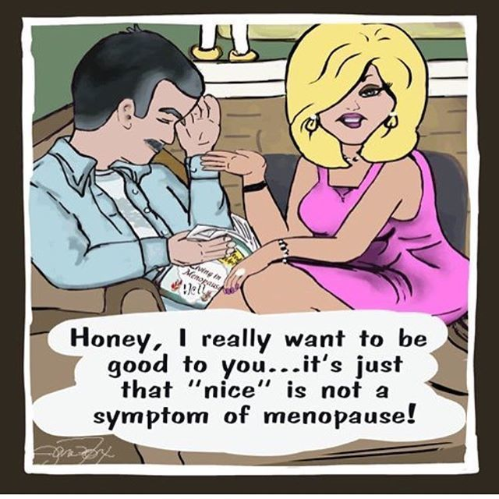
Common symptoms of menopause and perimenopause
Changes to your periods | They become irregular and eventually stops
Mental health symptoms | Changes to your mood, like low mood, anxiety, mood swings and low self-esteem Problems with memory or concentration (brain fog) Reduced sex drive
Image credit: https://www.pinterest.co.uk/pin/589338301209199763/

Slide 10
Physical symptoms
https://tradetraveljournal.com/signs-and-symptoms-of-menopause-infographic/
Notes:
Hot flushes – sudden feelings of hot or cold
Difficulty sleeping – due to night sweats
Palpitations – heartbeats become more noticeable
Headaches – worse than usual
Muscle aches and joint pains
Changed body shape and weight gain
Vaginal dryness and pain, itching or discomfort during sex
Recurrent urinary tract infections (UTIs)

Slide 11
How long symptoms last?
Symptoms can last for months or years, and can change with time.
See a GP or nurse if you think you have perimenopause or menopause symptoms
You can also speak to a pharmacist for advice about treatments and things you can do.
Getting advice early can help reduce the impact perimenopause and menopause have on your health, relationships and work.

Slide 12
Lifestyle changes to help menopause
Get plenty of rest and regular sleep routines
Eat a healthy diet
Have calcium-rich food like milk, yoghurt
Exercise regularly
Do relaxing things like yoga, tai chi or meditation
Talk to other people going through the same thing, like family, friends or colleagues
Talk to a doctor before taking herbal supplements or complementary medicine
Do not smoke
Do not drink more than the recommended alcohol limit

Slide 13
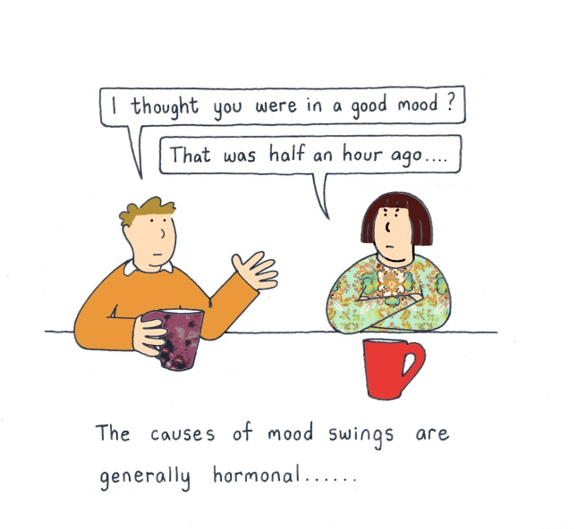
How to ease mood changes?
It's common to have mood swings, low mood and anxiety around the time of the menopause and perimenopause.
Try to:
get plenty of rest
exercise regularly
do relaxing activities
Cognitive behavioural therapy (CBT) is a type of talking therapy that can help with a low mood and feelings of anxiety. It can also help with sleep problems.
http://flashfree.me/2012/02/24/friday-folly-mood-swings-menopause-and-insanity/

Slide 14
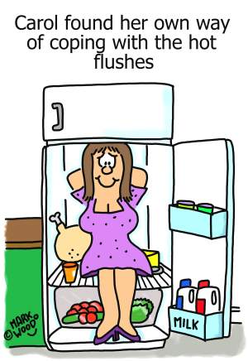
How to ease hot flushes and night sweats?
Wear light clothing
Keep your bedroom cool at night
Take a cool shower, use a fan or have a cold drink
Try to reduce your stress level
Avoid or reduce potential triggers, such as spicy food, caffeine, hot drinks, smoking and alcohol
Exercise regularly
Lose weight if you're overweight
http://www.markwoodcartoonist.myzen.co.uk/menopause1.html

Slide 15
How to ease vaginal dryness?
There are vaginal moisturisers or lubricants you can get without a prescription at a pharmacy.
You can talk to a pharmacist in private if you'd like help to decide which moisturiser is right for you.
If you're having sex and using condoms, do not use oil-based lubricant as this can damage condoms. You can use a water-based lubricant.
There are other treatments for vaginal dryness that a doctor can prescribe, such as HRT (hormone replacement therapy) or hormonal treatment (creams, pessaries, gel or vaginal rings).

Slide 16
Protecting against weak bones
Exercise regularly, including weight-bearing exercises, where your feet and legs support your weight (like walking, running or dancing) and resistance exercises (for example, using weights)
Eat a healthy diet that includes plenty of fruit, vegetables and sources of calcium, such as milk, yoghurt and kale
Get some sunlight on your skin as this triggers the production of vitamin D, which can help keep your bones healthy
Take vitamin D supplements
Stop smoking and cut down on alcohol

Slide 17
Treatment for menopause and perimenopause
The main medicine treatment for menopause and perimenopause symptoms is hormone replacement therapy (HRT), which replaces the hormones that are at low levels.
Your GP or a nurse will discuss any risks with you.
There are different types and doses of HRT. Using the right dose and type usually means your symptoms improve.
Oestrogen comes as:
skin patches
a gel or spray to put on the skin
implants
tablets
If you have a womb (uterus) you also need to take progesterone to protect your womb lining from the effects of oestrogen.
Taking oestrogen and progesterone is called combined HRT.
There are non-hormone treatments if your symptoms are having a big impact on your life and you cannot, or choose not to, have HRT.

Slide 18
Follow-up appointments
If you're having treatment for your symptoms of menopause or perimenopause, you'll need to return to the doctor or nurse who is prescribing your HRT for a follow-up review after 3 months.
When you and your doctor or nurse agree your treatment is working well for you, you'll need to see them once a year.
During your reviews, your doctor or nurse may:
make sure your symptoms are under control
ask about any side effects and vaginal bleeding
check your weight and blood pressure
review the type of HRT you're taking and make any necessary changes
You may need treatment for a few years, until most of your menopause and perimenopause symptoms have passed.

Slide 19
Help and support
Speak to a healthcare professional
A GP, nurse or pharmacist can give you advice and help with your menopause or perimenopause symptoms.
There are also menopause specialists who have experience in supporting anyone going through perimenopause and menopause.
Find your nearest NHS or private menopause specialist on the British Menopause Society website (this lists NHS and private specialists)
Find an NHS talking therapies service

Slide 20
Q&A

Slide 21
Jane Owen
Link worker

Slide 22
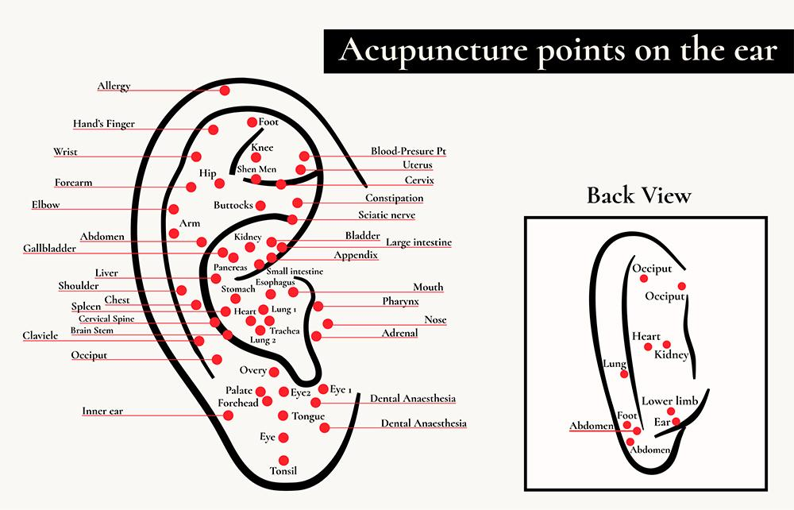
Menopause Support App
Cooling devices
Holistic Therapies

Slide 23
Q&A

Slide 24
Experiences with Menopause

Slide 25
Feedback survey:
We would really appreciate some feedback from these ‘Let’s Talk’ sessions, so we can constantly improve.
Please take 5 minutes to fill out this short survey. All feedback will be anonymous. Thank you.
Survey link:
https://forms.gle/toE8Nr2mXMKJwPxv7
Notes:
https://forms.gle/toE8Nr2mXMKJwPxv7 - survey link

Slide 26
Upcoming Let’s Talk Event:
‘Let’s Talk… Eating Disorder Awareness’
Open to both the public and professionals
Wednesday 15th February :3pm-4pm via Zoom

