Slide 1
Let’s Talk… Breastfeeding Awareness

Slide 2
Ground Rules
If we lose you during the session or you have wifi connection issues, please rejoin the meeting, following the same link/meeting ID and password.
To limit background noise, please keep your microphone off unless speaking.
This is an information giving session, rather than a clinical advice session.
Any questions for our guest speakers should be asked at the end of their session, during the Q&A section.
Please use the chat or raise your hand to connect with our guest
……. And lastly ..…..
Please be respectful to each other and each others opinions.
Thank you for attending and we hope you enjoy the session.

Slide 3
Today’s Programme
Session Overview:
Sam Longley - Public Health Specialist
Breastfeeding borough declaration
Question & Answer opportunity
Gaynor Chambers - Lead Midwife for Infant Feeding
What the service does
How to access service
How the service supports people
Question & Answer opportunity
Michelle Bannon - Maternity Voices Partnership
Michelle’s personal experience
How to access Maternity Voices Partnership service
Question & Answer opportunity
Any other Business and August ‘Let’s Talk’ Event Details
Let’s get to know each other...
What is your name and where are you from? (Add it to the chat box)

Slide 4
Breastfeeding Friendly Borough Declaration
Sam Longley

Slide 5
Our commitment
The Council recognises it is committed to protecting, promoting and supporting breastfeeding through advocacy to the whole of its population, whether they be a member of the public or a member of staff.
Notes:
To achieve this, we support the implementation of a Breastfeeding Borough, which includes some of the measures from the Baby Friendly Initiative (BFI) and adapt these to our local authority ethos and services where appropriate

Slide 6
Stage 1 - Building a firm foundation
The council will have a signed statement about it’s commitment to breastfeeding.
The Council will maintain an evidence based understanding and approach to breastfeeding.
Collaborative work with partners.
Notes:
We will share this with all new starters via our electronic induction system and, where appropriate, will have a routine reminder of this policy through our annual training updates
This will inform our commissioning and our wider public health agendas.
we will hold central the well-being of the baby and their mother / parents.

Slide 7
Stage 2- An Educated Workforce
Leadership team across the Local Authority to understand the health and well being benefits of breastfeeding.
Raise the profile of breastfeeding across all area of the local authority.
Notes:
through social media postings and local campaigns.

Slide 8
Stage 3 – Parent infant feeding experience
Support wider health and wellbeing strategies that support the promotion of breastfeeding.
Advocacy
Local and national campaigns
Notes:
1001 days, the Rotherham Healthy Weight Declaration, the Inequalities and Prevention Strategy and promote the importance of breastfeeding for the health and well-being of their baby.
support infrastructure which promotes, and supports breastfeeding for every mother and every baby.
Recognise that breastfeeding has multifaceted complex challenges within our population

Slide 9
Breastfeeding Borough Committment
Places
Breastfeeding friendly workplace
Supporting the International Code of Marketing of Breastmilk Substitutes

Slide 10
Q&A

Slide 11
Gaynor Chambers - Lead midwife for infant feeding

Slide 12
Q&A

Slide 13
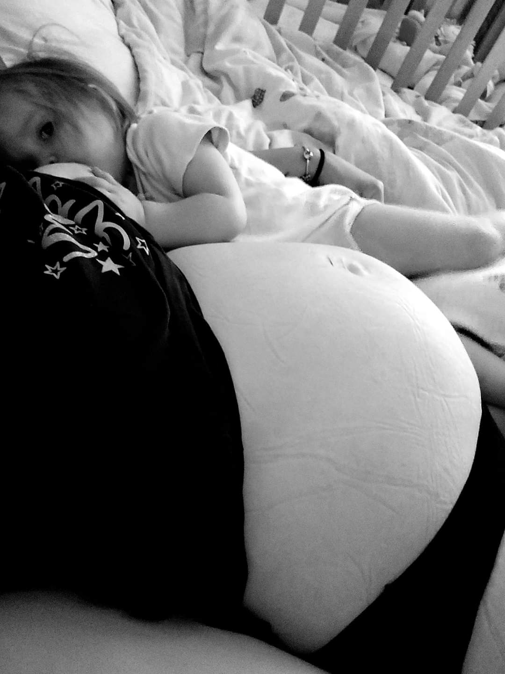
Michelle Bannon - Maternity Voices Partnership
“As a mum to 11 children who have all been breastfed for various amounts of time ranging from a couple of weeks to 3.5 years. I feel that I have, shall we say, a fair bit of knowledge in the breastfeeding field. I'm currently breastfeeding my 2 year old and 11 month old. “

Slide 14
Michelle’s experience
“It’s not always been the easiest of journeys with challenges along the way including breastfeeding a premature baby who was born at 32 weeks, dealing with tongue ties, tandem feeding and also triandom feeding (feeding 3).However, each journey has been amazing and special to me, something that I wouldn't change for the world. The challenges I faced I wouldn't have got through without the support from the lovely infant feeding team, mainly Debbie who is just amazing at what she does.
I've been lucky that I have such a supportive husband who has been my biggest cheerleader when I've felt like I can't do it anymore (yes even I have those moments). It makes the world of difference if you have that support who knows how much breastfeeding means to you and can help out in other ways like make lunch or clean up whilst you feed the baby (or sit and pretend to hehe.)”

Slide 15
A piece of advice
“If there's one piece of breastfeeding advice I could give to anyone who is thinking of breastfeeding is to look at the baby not the clock. You hear all these stories that babies will feed every 3 hours and settle in between! That's not always the case, some babies will want to feed every hour and that is absolutely normal, some babies might feed every hour through the day then do a good stint at night, that's also normal. Some babies may well feed every 3 hours and again that is also normal! Look up realistic expectations and read stories. Ask for help if you need it.”

Slide 16
“14 years ago I did the La Leche breastfeeding peer supporter course and 11 years ago I did a Rotherham breast buddies course. I ran a breastfeeding group for a few years at my local children's centre which was lovely. For the last 4 years I have been a member of Rotherham MVP (Maternity Voices Partnership) and 2 years ago I became co chair. I absolutely love what we do and the posters tell you what we are about and how you can get involved. We are also on Facebook and would love a follow”

Slide 17
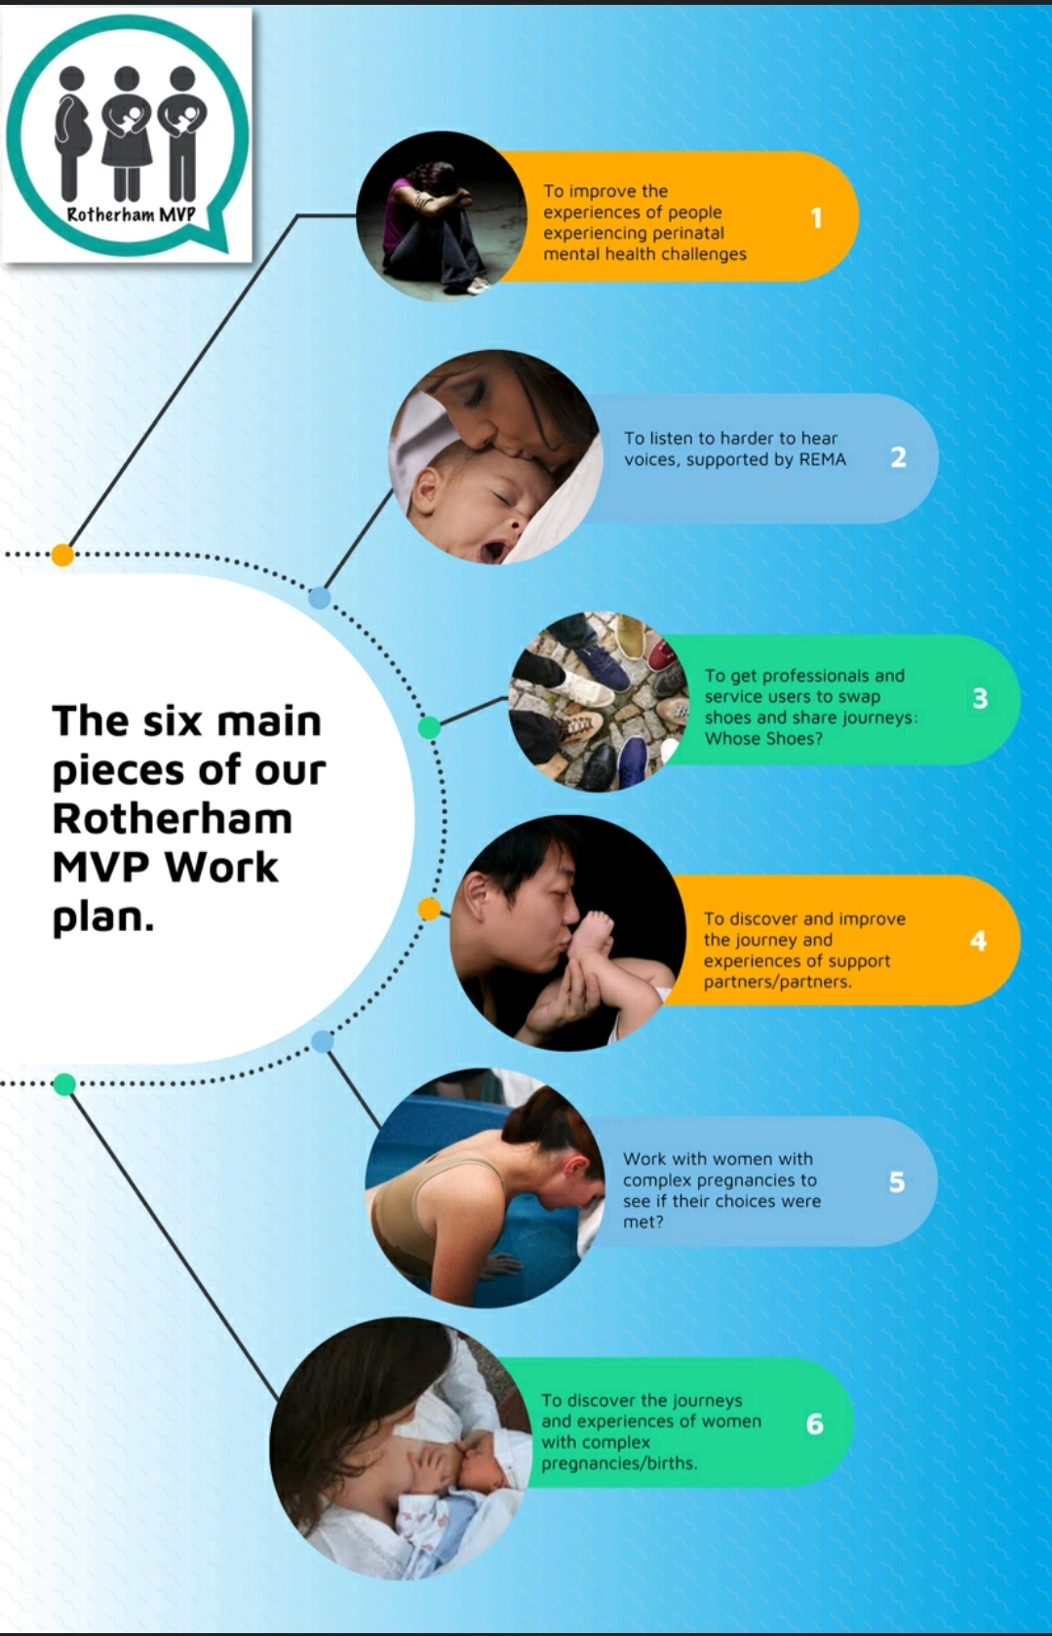

Slide 18
Q&A

Slide 19
Feedback survey:
We would really appreciate some feedback from these ‘Let’s Talk’ sessions, so we can constantly improve.
Please take 5 minutes to fill out this short survey. All feedback will be anonymous. Thank you.
Survey link:
https://forms.gle/toE8Nr2mXMKJwPxv7
Notes:
https://forms.gle/toE8Nr2mXMKJwPxv7 - survey link

Slide 20
Upcoming Let’s Talk Event:
‘Let’s Talk… Suicide awareness’
With guest speaker Ruth Fletcher Brown from RMBC
Open to both the public and professionals
Wednesday 28th September : 11am-12pm via Zoom
Book in online via our website https://healthwatchrotherham.org.uk/event/2022-09-28/lets-talksuicide-awareness

