Slide 1
Let’s Talk… Breast Cancer Awareness

Slide 2
Ground Rules
If we lose you during the session or you have wifi connection issues, please rejoin the meeting, following the same link/meeting ID and password.
To limit background noise, please keep your microphone off unless speaking.
This is an information giving session, rather than a clinical advice session.
Any questions for our guest speakers should be asked at the end of their session, during the Q&A section.
Please use the chat or raise your hand to connect with our guest
……. And lastly ..…..
Please be respectful to each other and each others opinions.
Thank you for attending and we hope you enjoy the session.

Slide 3
Today’s Programme
Session Overview:
Sophie Kirby - CoppaFeel
What is Coppafeel
How the charity supports those with breast cancer
Signs and Symptoms
Faye Mcdool - Cancer Advocacy
What is Cancer Advocacy
How the service supports people
How to contact the service
Leon - Functional Fitness
What is Functional fitness
How the service supports people with breast cancer/ cancer in general
How to contact the service
Any other Business and August ‘Let’s Talk’ Event Details
Let’s get to know each other...
What is your name and where are you from? (Add it to the chat box)

Slide 6
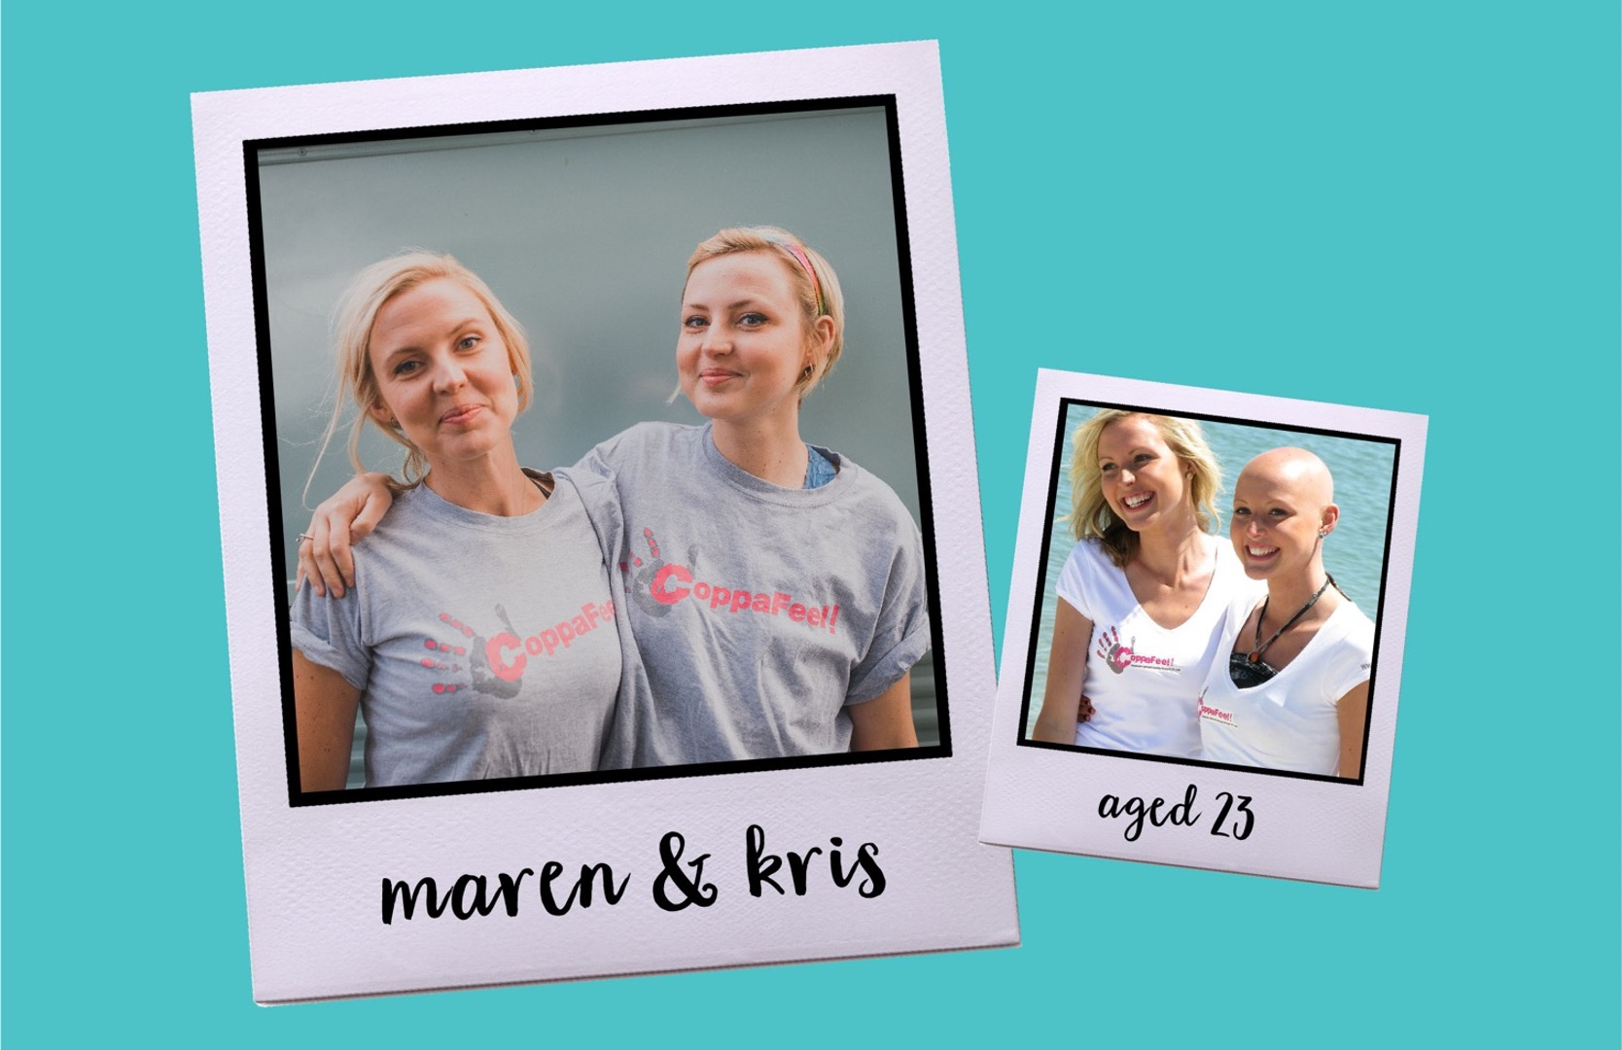

Slide 7
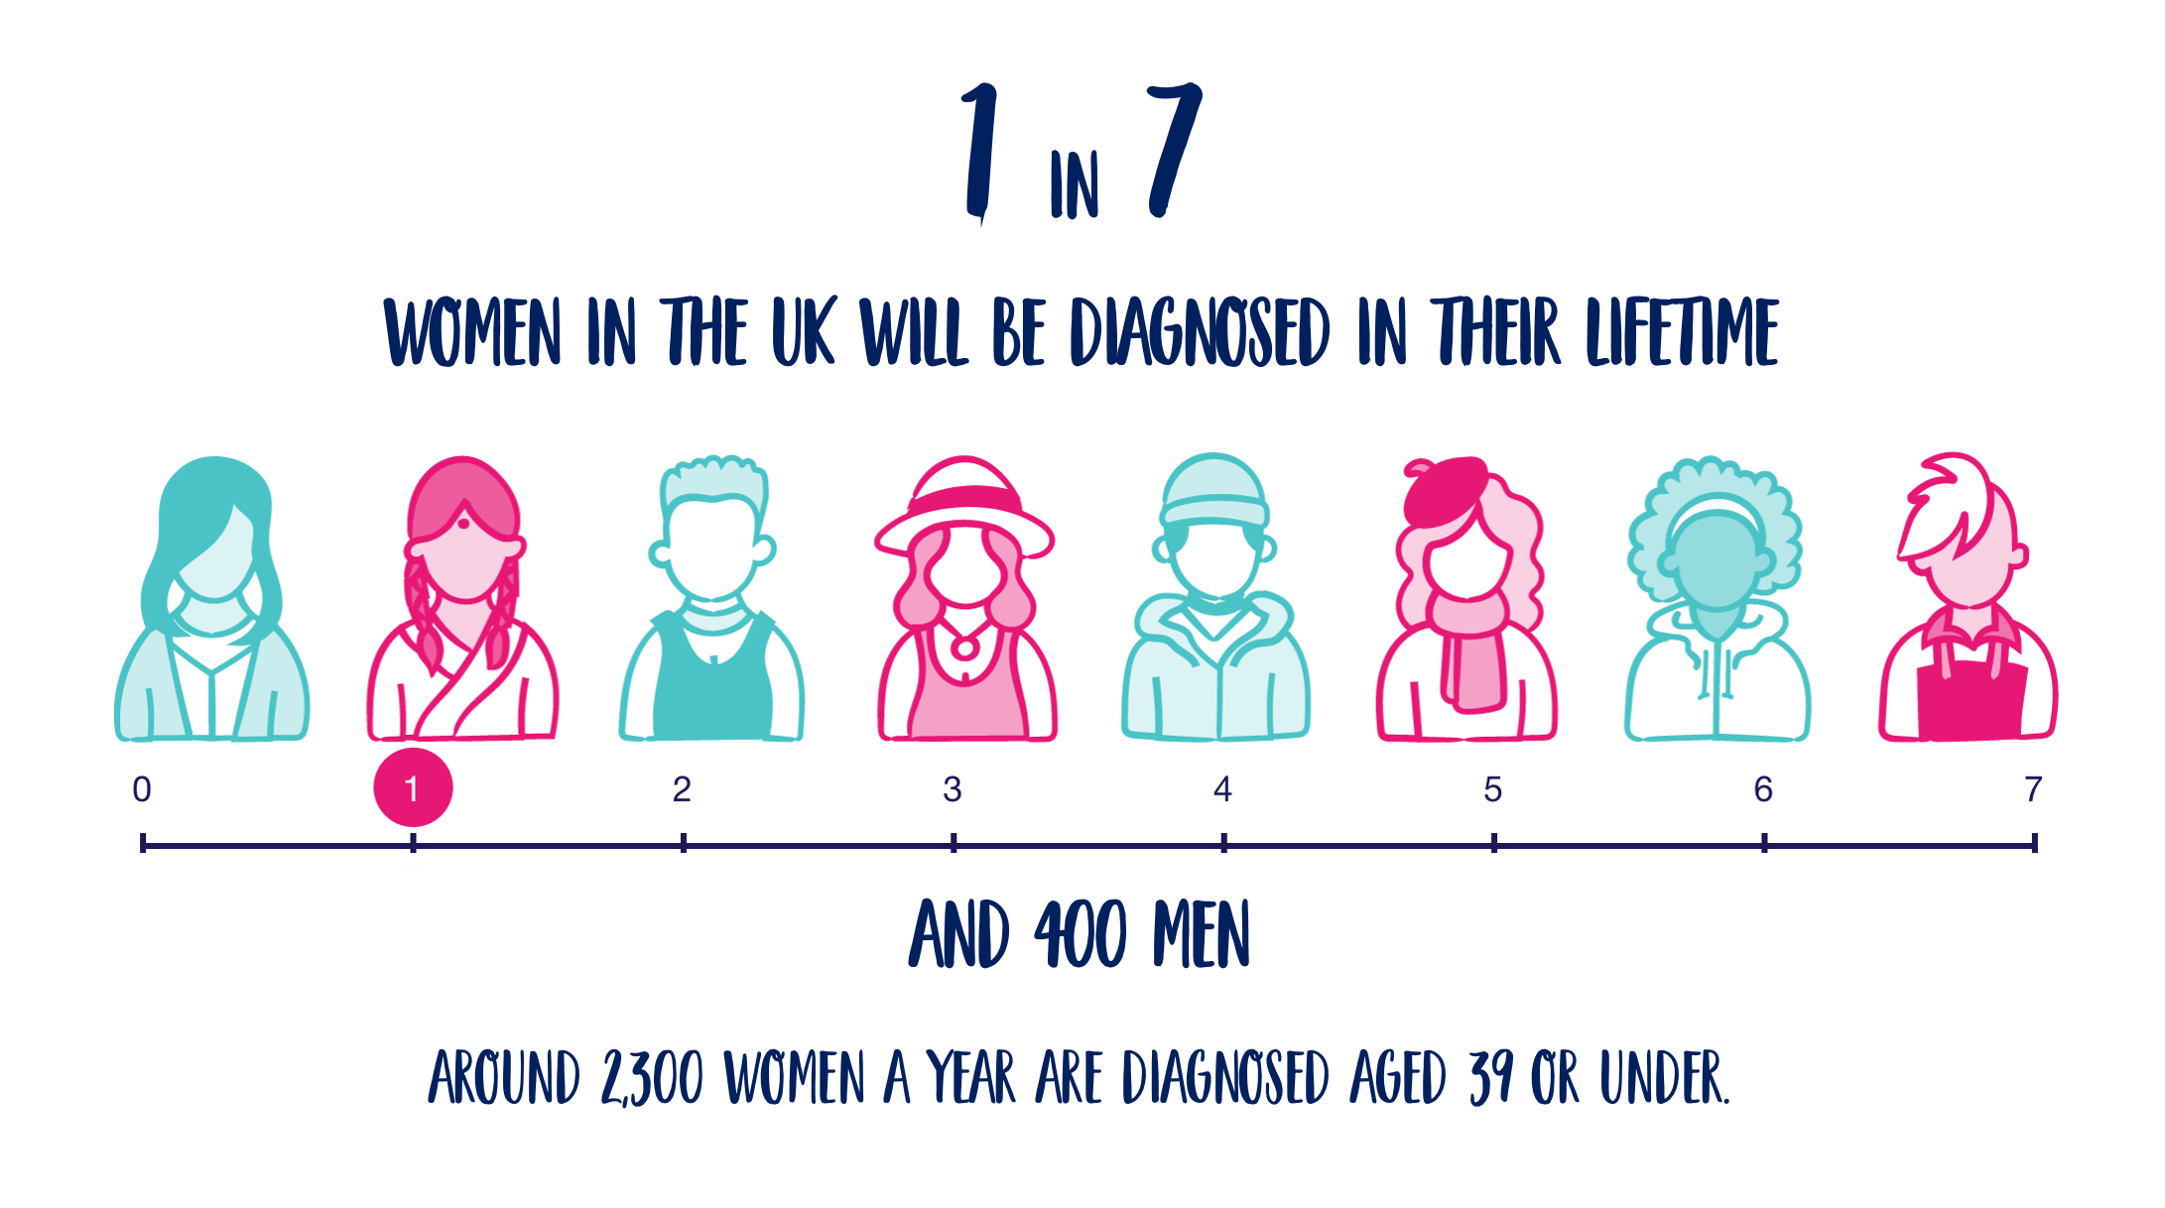

Slide 8
Look AND feel!
ALL breast tissue (under your armpit and up to your collarbone.)
Check roughly once a month.
Get to know YOUR normal!

Slide 9
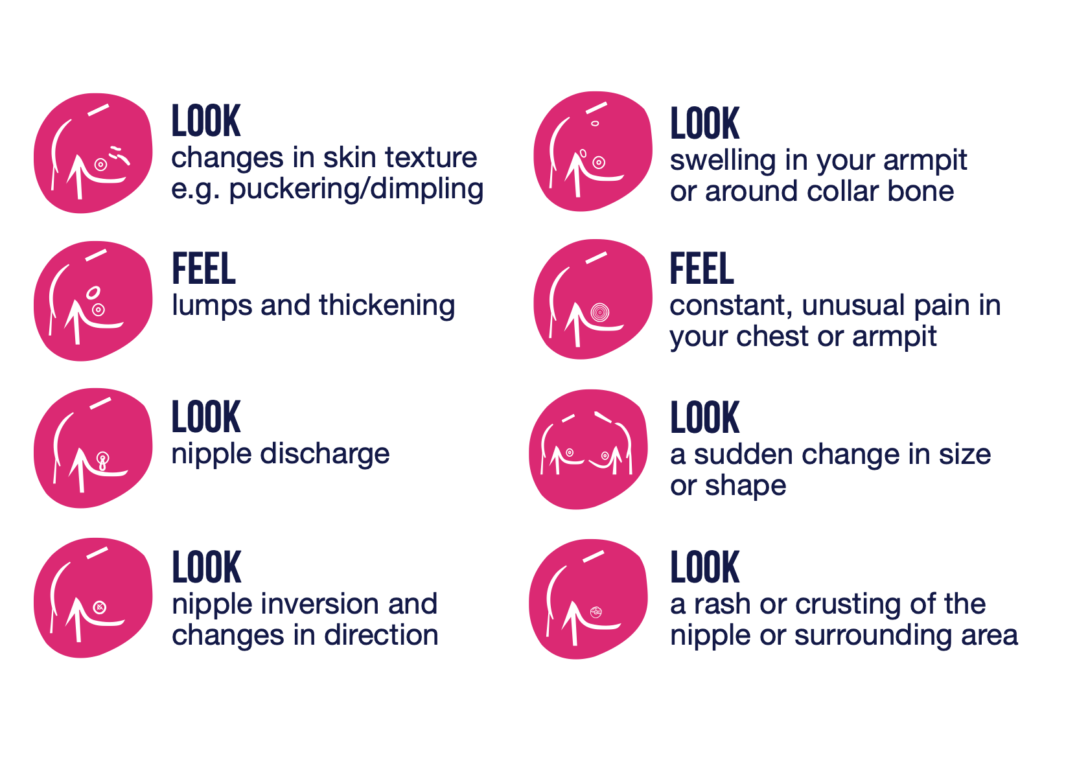

Slide 10
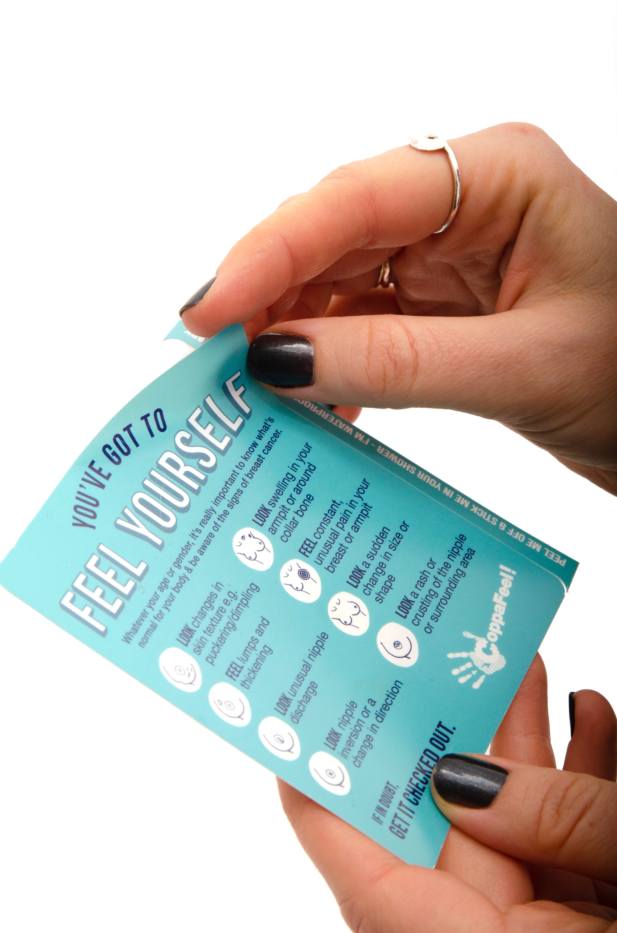
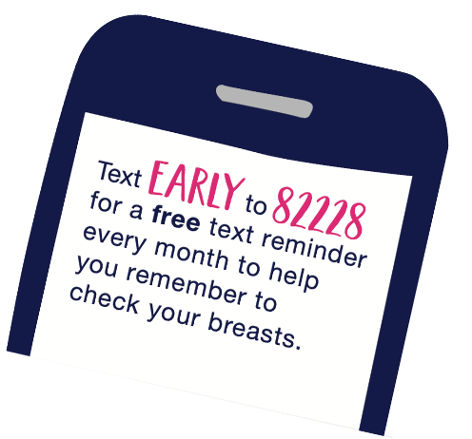
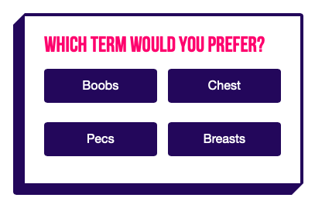
How we can support you
coppafeel.org

Slide 11
Sophiek@coppafeel.org

Slide 12
Rotherham Cancer Advocacy Service
For people affected by cancer

Slide 13
Cancer
Cancer is the disease people in the UK fear most, and for one in ten people, it’s their biggest fear of all.
One in two of us will receive a cancer diagnosis in our lifetime
Whilst cancer is always life changing, it isn’t always life ending
People are now twice as likely to survive at least 10 years after being diagnosed with cancer than they were at the start of the 1970s
While many people go on to live full lives and are able to put their experience behind them, many others struggle with the physical, emotional and financial effects of a cancer diagnosis and treatment for years after.
Around 1,600 people diagnosed with cancer in Rotherham in 2019

Slide 14
Effects of a cancer diagnosis:
People affected by cancer have individual needs that cannot always be fully addressed by their health care providers or usual support networks.
Some of the issues people living with cancer are most worried about are:
Finance - four in five people with cancer are £900 a month worse off
Carers - 1.5 million people care for someone with cancer, half of them don’t get any support. What about carers who have cancer?
Family - People worry about what will happen to their children/pets
Treatment - Some treatments for cancer can have short and long term side effects and consequences
Managing at home - coping with everyday practical stuff whilst in treatment and recovery
Body Image - Having treatment can change how you look and feel about yourself for example hair loss, scarring, loss of a body part or having a stoma
Mental wellbeing - a cancer diagnosis can affect the emotional health of patients, families, and caregivers. Common feelings during this life-changing experience
Notes:
Cancer is the disease people in the UK fear most, and for one in ten people, it’s their biggest fear of all.
One in two of us will receive a cancer diagnosis in our lifetime
Whilst cancer is always life changing, it isn’t always life ending
People are now twice as likely to survive at least 10 years after being diagnosed with cancer than they were at the start of the 1970s
While many people go on to live full lives and are able to put their experience behind them, many others struggle with the physical, emotional and financial effects of a cancer diagnosis and treatment for years after.
Around 1,600 people diagnosed with cancer in rotherham in 2019

Slide 15
Cancer Advocacy Service
Being diagnosed with cancer is a shock and we understand that could leave someone feeling overwhelmed, worried about what happens next or thinking about the impact on your life. Having someone to talk to, who can provide the right information and support at a time when they need it, can make a huge difference.
An Advocate can help by -
Listening and giving time to talk about worries and concerts
Supporting by finding and access the right services or information
Empowering clients to make their own decisions

Slide 16
What is Advocacy?

Slide 17
How it started
There are some great services in Rotherham offering lots of support to help people affected by cancer to deal with many of these issues. However, knowing where or how to access them is not always easy especially if someone is dealing with cancer alone or feeling overwhelmed
Citizens Advice produced this free, impartial, independent, confidential and open to anyone affected by cancer where healthcare professionals could refer a patient/client quickly and easily to the service or clients can refer themselves.
Launched in 2018 funded by Macmillan
Originally opened to just three tumor sites who could refer into the service
Breast
Urology
Colorectal

Slide 18
Service update and current situation
From November 2018 - July 2021 the service supported 911 people living with cancer and still operated during COVID-19.
Macmillan funding ended in July 2021 but the service has maintained its partnership
Now funded by Clinical Commissioning Group (CCG) which started in August 2021
Accepting referrals from all tumor sites and any other partners
4 volunteer advocates and 1 paid part time officer
Since August 2021 unders its new funder, the service has supported over 450 people affected by cancer
Expanded access with virtual support and attending meetings/appointment with clients
Between the months of August - March, the service has had 229 clients under the service with an average, as well as 7 still open to the service who were referred in July before the new funding. There was an average of 28 monthly referrals into the service as well as referrals increasing on a monthly basis and 1,144 calls were made from August to March to clients. There are 94 clients still open to the service going into the next financial year.
Notes:
Average of 26 referrals in each month with on average around 50 clients being supported each month
Jan stats - The service this month has had 39 new referrals whilst still supporting 52 clients from previous months, meaning that the service this month alone has supported 91 people living or supporting those with cancer and have made 201 phone calls across the month. 33 cases have been closed this month and needs have been met. However, 72 clients are still with our service where our advocates are still supporting those individuals.

Slide 19
What Advocates Can and Can’t do:
Advocates can ‘support’ and ‘empower’ people to:
Make their own decisions
Talk to health workers for the client about what they want
Think about their own choices
Make a complaint
Provide knowledge about and how to access health and social care services and support
Speak up for their human rights
Tackle discrimination and stigma
Advocates do not:
Advise
Make decisions for clients
Make assumptions
Give them legal advice
Give them medical advice
Help them apply for benefits and entitlements (though our Adviser colleagues can do this)
Help them to claim compensation
Provide befriending
Provide an emergency support service

Slide 20
What clients typically access the service for
* Gain information on diagnosis and treatment and supporting with dealing with the effects
* To be listened to and supported with dealing with emotions and stress
* For support and to be provided with information with managing day to day tasks
* To discuss money worries or finding out about benefits
* To be provided with information on employment issues
* For someone to listen to their family and relationship issues
* For information and support with sourcing support with looking after partners with caring needs, children and pets
* To be empowered to plan for the future
* To be signposted to other cancer services for alternative support
We will support clients in dealing with the things that are important to them.

Slide 21
Referrals
Accept referrals via Refernet
Main referrals are from Cancer Nurse Specialists
Open to all tumour sites!
Accept re-Referrals
Open to service partners
Self Referrals:
Call 01709 515680 (option 3)
Email Advocacy@citizensadvicerotherham.org.uk

Slide 22
Some other cancer related services and charities in Rotherham external to Citizens Advice
Notes:
Well aware that there are other services operation in other areas of Sheffield Barnsley and Doncaster so please excuse if any are not listed

Slide 23
Financial
Citizens Advice Rotherham & District provides free, independent, confidential and impartial advice to everyone on their rights and responsibilities. Range of service to support client financial needs.
Telephone Advice by calling 0808 278 7911 Or 01709 515680
Specific services include, applying for benefits including the completion of application forms, means tested benefit calculations, challenging benefits decisions and tribunal, representation, accessing Macmillan and other charitable grants, applying for blue badges and help with bereavement benefits.
Access to the service is by referral from any health professional or self referral.
01709 823645 / macmillanwelfarerights@rotherham.gov.uk
Age UK Rotherham offers a free and confidential information and advice service for older people, their families and carers. They can also support in completing forms.
Telephone Advice calling 01709 835 214 or email: info@ageukrotherham.org

Slide 24
Support
Patients with active, progressive and advanced terminal disease are eligible for hospice services. This includes patients with both malignant disease and non-malignant diseases for example, cancer, heart disease, lung disease and neurological diseases. Hospice services include Day Hospice, Hospice Community Team and Inpatient Unit.
Referrals depend on the service required
Rotherham Cancer Care Centre has been supporting local people who have cancer or have been affected by cancer. Through one to one assessment they give people time to talk about their fears and concerns and provide complementary therapies and/or counselling to improve quality of life which is are free
Must have an assessment before accessing service and can self refer.
Notes:
Bluebell Wood Children's Hospice
Cavendish Cancer Care (cavcare.org.uk)
Welcome To The Yorkshire Cancer Patient Forum - Yorkshire Cancer Community
Weston Park Cancer Centre

Slide 25
Physical Activity
Exercise Rehabilitation classes are to tackle and overcome the barriers people face in accessing high quality, safe physical activity, and exercise. The trainers utilise their knowledge, experience and understanding to create specialist exercise programmes for people with cancer and other long term health condition.
Tuesdays & Thursday 09:30 – 10:30 & Tuesday 15:00 - 16:00
Exercise Rehabilitation classes cannot be booked, and a GP referral is required to attend.
Living with and beyond cancer programme has a clear aim, to ensure anyone who has been affected by cancer has a safe, welcoming, friendly and fun environment where they can get back to being them. The circuit-based classes can be done seated or standing, and everyone is encouraged to take things at their own pace.
Mondays 11:00-12:00
Number of referral pathways
Notes:
Rotherham Cancer Care
Bluebell Wood Children's Hospice
Cavendish Cancer Care (cavcare.org.uk)
Services - Citizens Advice Rotherham
Welcome To The Yorkshire Cancer Patient Forum - Yorkshire Cancer Community
Weston Park Cancer Centre

Slide 26
Transport
Weston Park Cancer Charity are now offering support in Rotherham for transport. Service will run twice daily at 9am and 1:30pm Pick up from Rotherham United FC’s AESSEAL New York Stadium on New York Way. Latest return times 5pm - Better to call
transport@wpcancercharity.org.uk
0114 553 3330
The Firefly Express vehicles provide free transport to local cancer patients and their families in the Rotherham to regional treatment hospitals, using their fantastic team of volunteer drivers. They currently have a fleet of eight vehicles to cope with the ever-increasing requirements.
info@firefly-support.co.uk
Call 07738 390541
Notes:
Well aware that there are other services operation in other areas of Sheffield Barnsley and Doncaster so please excuse if any are not listed

Slide 27
Cancer Support in Surrounding Areas: Sheffield
Weston Park Cancer Charity is here to face cancer with you. The services, advice, therapies and support are for you and the people close to you, helping everyone to live with and beyond cancer.
Cancer support
Managing physically
Managing financially
Managing emotionally
Managing practically
Transport service
charityteam@wpcancercharity.org.uk
0114 553 3330
Support, Counselling and Complementary Therapies.
Specialist services for Children and Young people.
Courses and classes to introduce simple, effective techniques to help people feel calmer, more relaxed and in control.
Fill in a online form or call 0114 2784600. They are a self-referral service (you don’t need to be referred by a healthcare professional) and they aim to see you within 5 working days of you making contact with them
Fans FC is a programme designed to support those diagnosed with, affected by, or to help prevent, cancer. In partnership with the Premier League Charitable Fund and Weston Park Cancer Charity there Fans FC programme aims to provide FREE mental and physical support to those that need it.
contact health@sufc-community.co.uk or fill in online registration
Notes:
Well aware that there are other services operation in other areas of Sheffield Barnsley and Doncaster so please excuse if any are not listed

Slide 28
Cancer Support in Surrounding Areas:
Doncaster
Aurora is a local charity providing free cancer support at centres and online in Bassetlaw, Doncaster and Mexborough. They can help with emotional support, beauty therapy, hair care, exercise, nutrition, courses & workshops and support groups.
Bassetlaw 01909 470985
DRI 01302 644662
Mexborough 01709 649122
St John’s Living Well Centre: St John’s Living Well Centre offers support to anyone who wants to talk about how cancer is affecting their life, whether this is someone with cancer or somebody with a close relationship to someone with cancer. This can be done over the phone, at an appointment in the centre or through a home visit.
Call 01302 796 666
The Firefly Express vehicles provide free transport to local cancer patients and their families in the borough of Doncaster to regional treatment hospitals, using their fantastic team of volunteer drivers. They currently have a fleet of eight vehicles to cope with the ever-increasing requirements.
Call 07738 390541
Notes:
Services - Citizens Advice Rotherham
Welcome To The Yorkshire Cancer Patient Forum - Yorkshire Cancer Community

Slide 29
Cancer Support in Surrounding Areas:
Barnsley
Barnsley Cancer Action Group
Group of local people that have all been affected by cancer in some way and have all had different experiences, encountering good and bad care and communication.
Meet every quarter.
Set to relaunch
The Well is a Complementary and Beauty Therapy service which is available to all cancer patients in Barnsley.
http://www.thewellforwellbeing.org.uk/

Slide 30
Cancer Support in Surrounding Areas
Look Good Feel Better is a leading cancer support charity aimed at boosting the physical and emotional wellbeing of people living with cancer.
Currently they provide online workshops covering skincare and make-up; grooming; hair loss, haircare and wig advice and nail care.
www.lookgoodfeelbetter.co.uk
Providing impartial, independent information and listening to those affected by cancer to ensure that they are supported and their voices elevated.
Also run a online community group every Tuesday 11am – 12pm
info@yorkshirecancercommunity.co.uk
01924 787379
CSUK offer Cancer Kits to people currently undergoing treatment as a practical aid to recovery.
They have Cancer Kits, Chemo Kits and Kids’ Kits, which they supply free of charge. The Kits include practical items for people receiving cancer treatment.
https://cancersupportuk.org/

Slide 31
Any Questions?

Slide 32
Reference
https://www.ndti.org.uk/resources/new-advocacy-charter
https://ajcasemanagement.com/

Slide 33
Leon - Functional Fitness

Slide 34
Q&A

Slide 35
Breast Cancer Awareness
Ann Parkin
Macmillan Clinical Nurse Specialist in Breast

Slide 36
What is Breast Cancer
Cells in the breast tissue divide and grow out of control
Most commonly starts in the ducts, can also start in the lobules.
1 in 8 women will get Breast Cancer
Risk factors, Family history, obesity, Alcohol
Men can also get breast cancer

Slide 37
Signs and Symptoms
A lump or swelling in the breast, upper chest or armpit
A change to the skin, such as puckering or dimpling
A change in the colour of the breast – the breast may look red or inflamed
A nipple change, for example it has become pulled in (inverted)
Rash or crusting around the nipple
Unusual liquid (discharge) from either nipple
Changes in size or shape of the breast
Screening for breast cancer 3 yearly 47 – 73 yrs

Slide 38
Treatments
Surgery. Lumpectomy/Mastectomy +/- reconstruction
Chemotherapy
Radiotherapy
Hormone therapy
Herceptin
Can take from only a few months to over a year

Slide 39
Side effects
Physical (fatigue)
Practical (work, finance, children)
Psychological ( body image, hair loss )
Emotional ( dealing with a cancer diagnosis)
Spiritual

Slide 40
Support
Family and friends
Macmillan advocacy service
Macmillan welfare rights
Transport – Firefly, WPCC charity bus
Improving access to psychological therapies.
Clinical psychologist
Rotherham cancer care centre ( complimentary therapies)

Slide 41
Any questions?

Slide 42
Know your breasts: Full guide
Know your breasts: Quick guide – this guide is available in 11 languages
Reducing your risk of breast cancer
Our Touch Look Check Campaign (TLC), infographic (in five different skin tones), summary postcard and short animation

Slide 43
Feedback survey:
We would really appreciate some feedback from these ‘Let’s Talk’ sessions, so we can constantly improve.
Please take 5 minutes to fill out this short survey. All feedback will be anonymous. Thank you.
Survey link:
https://forms.gle/toE8Nr2mXMKJwPxv7
Notes:
https://forms.gle/toE8Nr2mXMKJwPxv7 - survey link

Slide 44
Upcoming Let’s Talk Event:
‘Let’s Talk… Care homes/Home Care’
Open to both the public and professionals
Wednesday 23rd November :11am-12pm via Zoom

