Slide 1
Let’s Talk… Blood Pressure

Slide 2
Ground Rules
If we lose you during the session or you have wifi connection issues, please rejoin the meeting, following the same link/meeting ID and password.
To limit background noise, please keep your microphone off unless speaking.
This is an information giving session, rather than a clinical advice session.
Any questions for our guest speakers should be asked at the end of their presentation, during the Q&A section.
Please use the chat or raise your hand to connect with our guest
……. And lastly ..…..
Please be respectful to each other and each others opinions.
Thank you for attending and we hope you enjoy the session.

Slide 3
Let’s get to know each other...
What is your name and where are you from? (Add it to the chat box)

Slide 4
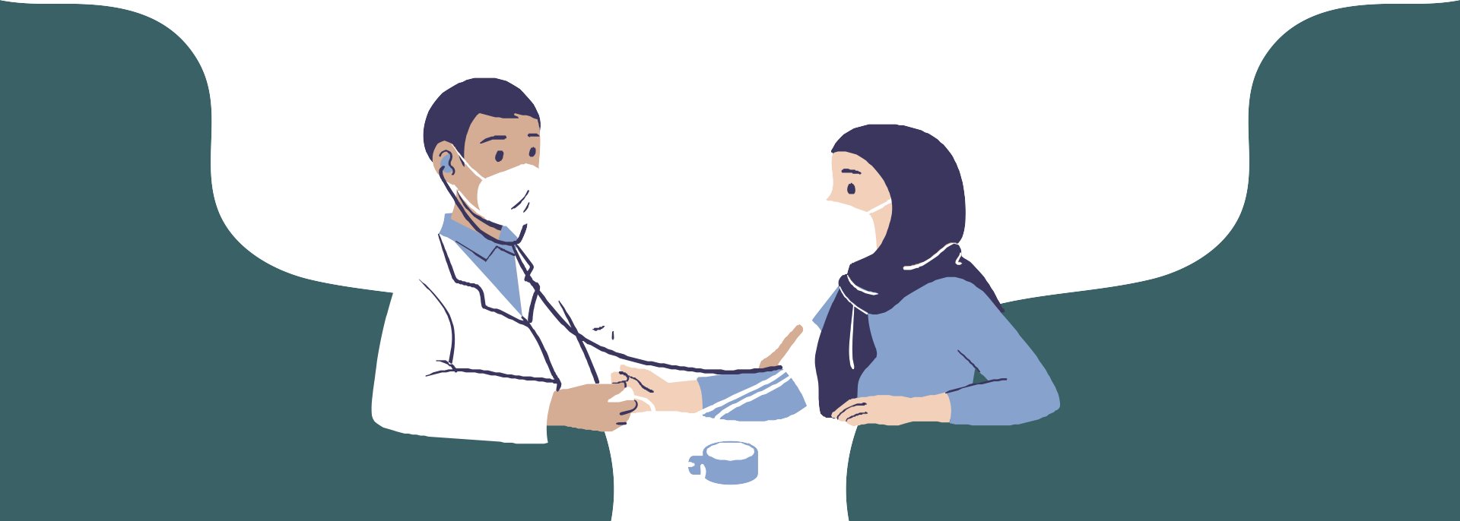
A PRESENTATION ABOUT
BLOOD PRESSURE
Healthwatch
Created by Sara Eckersley Health and Wellbeing Coach Dinnington Group Practice PCN

Slide 5
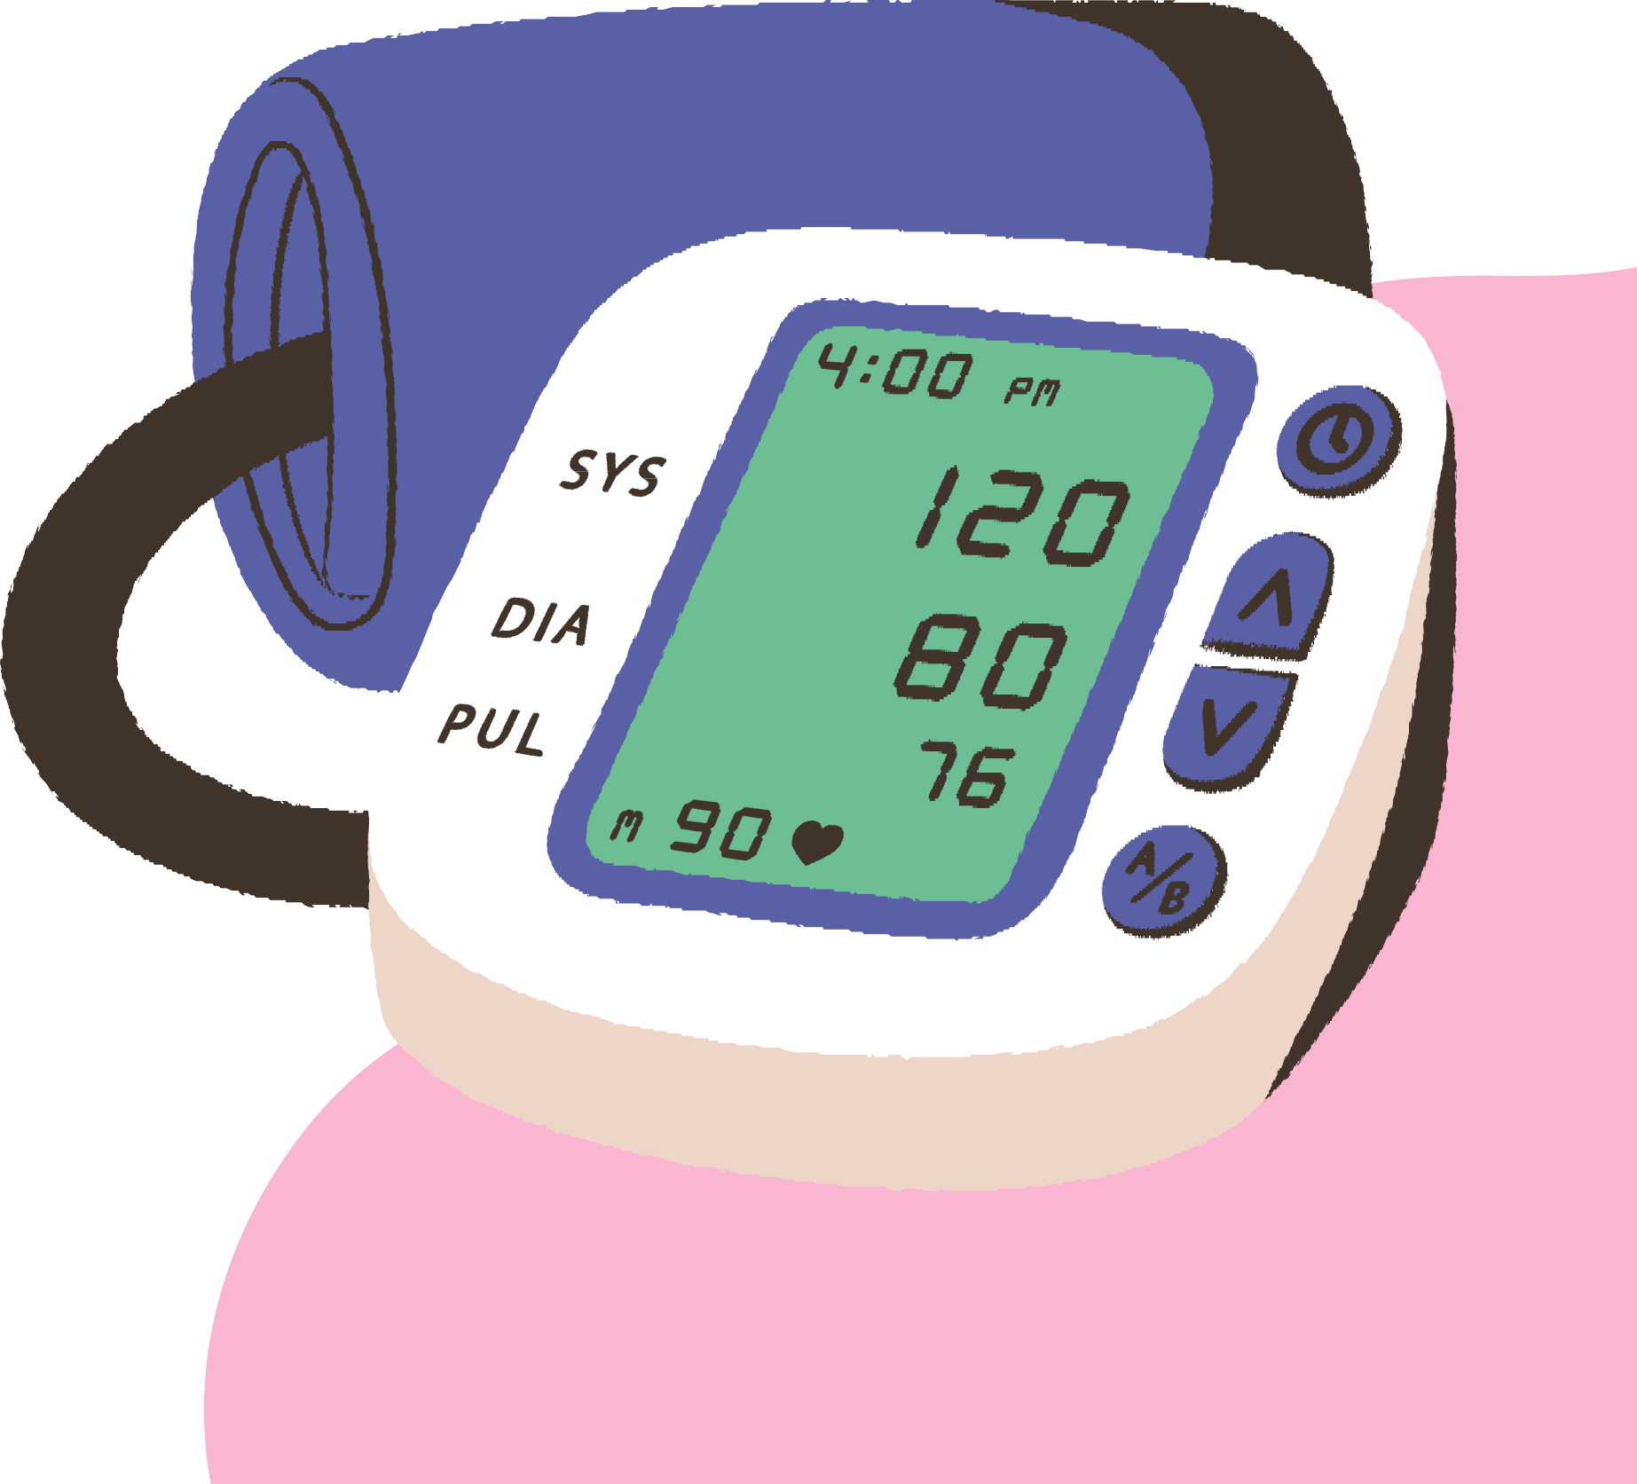
TODAY'S AGENDA:
Spreading awareness and information about blood pressure and how services can be accessed.
What is a good blood pressure reading?
How can blood pressure be affected?
If I have high blood pressure, what am I at risk of?
How can I get my blood pressure down?
What services are there for me to access?

Slide 6
WHAT DO ALL THE NUMBERS MEAN?
What should your blood pressure be?
Ideally, we should all have a blood pressure reading between 90/60mmHg and 120/80mmHg
140/90mmHg is the cut off point that many GPs use for diagnosing high blood pressure reading.

Slide 7
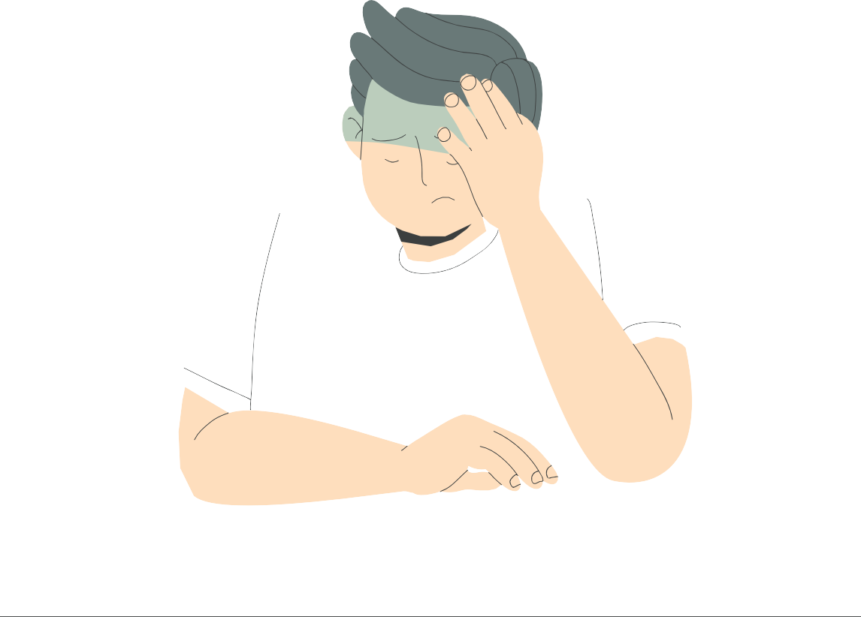
SYMPTOMS OF HIGH BLOOD PRESSURE
Blurred vision Nosebleeds Shortness of breath Chest pains Dizziness Headaches

Slide 8
IF I HAVE HIGH BLOOD PRESSURE, WHAT DOES THAT PUT ME AT RISK OF HAVING?
HEART DISEASE
HEART ATTACK
STROKES
KIDNEY DISEASE
VASCULAR DEMENTIA
HEART FAILURE

Slide 9
Diet
How can blood pressure be affected?
Physical Activity
/Exercise
Smoking
Weight
Alcohol
Stress Genetics

Slide 10
How can my diet affect my blood pressure?
DIET
Salt (6g or less a day, about a teaspoon)
Low in saturated fat
High in fibre Reduced red meat Plenty of fruit and vegetables

Slide 11
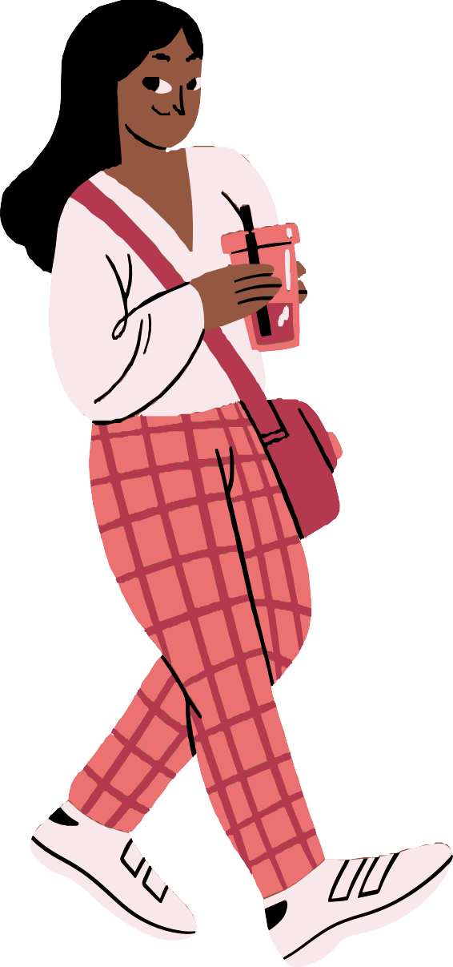
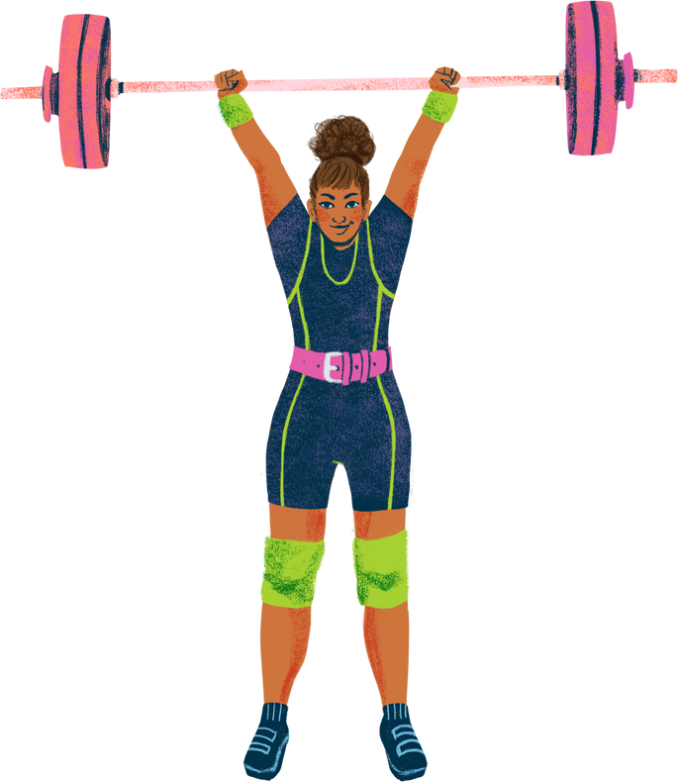
A lack of physical activity is linked to high blood pressure, and being more active will lower your blood pressure.
PHYSICAL ACTIVITY
Being active lowers your blood pressure
It's safe to exercise if you have high blood pressure, but it's a good idea to speak to a doctor before starting new physical activity.
Best kind of exercise to start with is aerobic, walking, light jogging.

Slide 12
Make sure that everyone gets help, support, and access to mental health professionals.
SMOKING
Each cigarette you smoke causes a temporary rise in blood pressure.
Smoking causes damage to the walls.
Smoking can cause blood clots leading to strokes and heart attacks.

Slide 13
Encourage everyone to set boundaries so they can spend time with their families, etc.
WEIGHT
Being overweight makes your heart heart pump blood around your body harder.
BMI will help you indicate if you're overweight
18.5 - 24.9 ideal
25 - 29.9 this is considered overweight, losing weight will help
30 + considered obese

Slide 14
Does drinking cause high blood pressure?
ALCOHOL
Binge drinking can lead to unwanted weight gain, causing blood pressure to go up.
Drinking a lot of alcohol can affect the muscles in your blood vessels. Causing them to be narrower, increasing your risk of high BP.
Stick to 14 units a week.

Slide 15
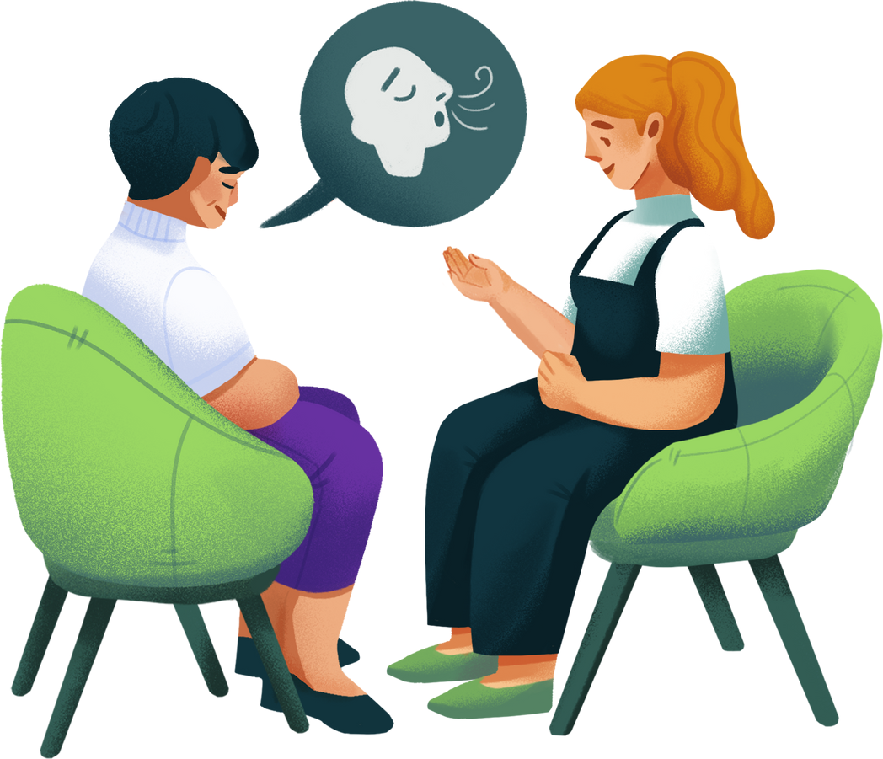
Does stress cause high
STRESS
blood pressure?
Yes, stress can cause your
blood pressure to raise for a period of time
When you're stressed your body releases hormones like adrenaline.
'Adrenaline makes your heart beat faster, and your blood pressure raises to cope with the situation.
Stress alone can't cause a heart attack, but the way we cope with it may increase our chances.

Slide 16
My parents have high blood pressure, does that mean I
GENETICS
have it?
Genes likely play some roles in high blood pressure.
However, it is also likely that people with a family history of high blood pressure share a common environments and other potential factors that increase their risk.

Slide 17
WHAT SERVICES ARE AVAILABLE?
BP clinics run across most surgery's. These can be done with a nurse, health care assistant or health and wellbeing coach.
Most GP's will have an automatic machine in the waiting room where you can take it and hand it to a receptionist to add to your record.
Your local pharmacist will be able to take your blood pressure.
Investing in your own BP machine is a great idea.
OMRON and GPZON.

Slide 18
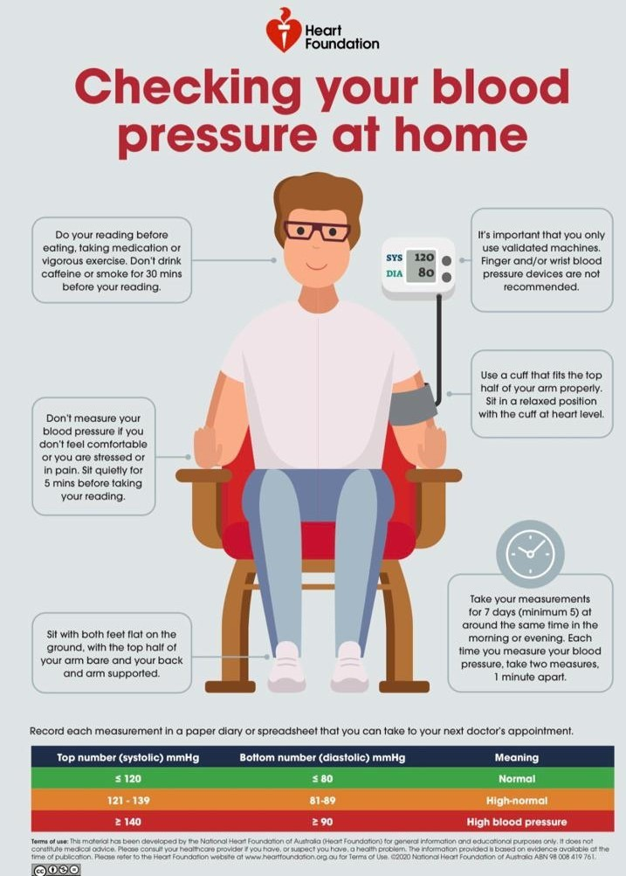

Slide 19
GET HEALTHY ROTHERHAM
(12 weeks free,
self referral or GP referral)
(Reduce alcohol,
a referral can be made through get healthy )
(Provide nicotine patches, every week support
for three months)

Slide 20
NHS DIGITAL WEIGHT MANAGEMENT
You must be 18 or over.
You must have a BMI greater than 30. The BMI threshold will be lowered to 27.5 for people from black, Asian, and ethnic minority backgrounds, as we know people from these ethnic backgrounds are at an increased risk of conditions such as Type 2 diabetes at a lower BMI.
You must have diabetes, high blood pressure, or both.
You must have a smartphone, tablet, or computer with internet access.

Slide 21
USEFUL WEBSITES TO FIND MORE INFORMATION
HAPPY HEARTS
NHS WEBSITE
BRITISH HEART FOUNDATION

Slide 22
ANY QUESTIONS?

Slide 23
Feedback survey:
We would really appreciate some feedback from these ‘Let’s Talk’ sessions, so we can constantly improve.
Please take 5 minutes to fill out this short survey. All feedback will be anonymous. Thank you.
Survey link:
https://forms.gle/toE8Nr2mXMKJwPxv7
Notes:
https://forms.gle/toE8Nr2mXMKJwPxv7 - survey link

Slide 24
Upcoming Let’s Talk Event:
‘Let’s Talk… Breast Cancer Awareness’
Open to both the public and professionals
Wednesday 26th October :11am-12pm via Zoom

