Slide 1
Let’s Talk… Access to dental care

Slide 2
Ground Rules
If we lose you during the session or you have wifi connection issues, please rejoin the meeting, following the same link.
To limit background noise, please keep your microphone off unless speaking.
Please use the chat and raise your hand buttons to connect with our guest speakers, to allow them to address your concerns individually.
This is a information giving, rather than a clinical advice, session.
Any questions for our guest speakers should be asked at the end of the session, during the Q&A section.
Please be respectful to each other and each others opinions.
Thank you for attending and we hope you enjoy the session.

Slide 3
Today’s Programme
Session Overview
Why dental care is important - Ellie Durband, Dental care professional
How to access dental care in Rotherham - Steve Thompson, Local Dental Committees Chair
Rotherham residents’ experience of access to dental care in the past 12 months - Healthwatch Rotherham to present results of survey
Advice and support for those struggling to access dental care Steve Thompson Local Dental Committees Chair
Planned improvements in dental care access - Steve Thompson Local Dental Committees Chair, Rotherham & quote from stakeholder update January 2022
Question & Answer opportunity
Any other Business and February Let’s Talk Event Details
Let’s get to know each other...
What is your name and where are you from? (please add in the chat box)

Slide 4
Why dental care is important:
Ellie Durband
Notes:
Talk:
“Our teeth have such an important role to play in our lives. They help us chew and digest food, they help us to talk and speak clearly and they also give our face its shape.
Your oral health is more important than you might realise. Like other areas of the body, your mouth teems with bacteria — mostly harmless. But your mouth is the entry point to your digestive and respiratory tracts, and some of these bacteria can cause disease. Normally the body's natural defences and good oral health care, such as daily brushing and flossing, keep bacteria under control. However, without proper oral hygiene, bacteria can reach levels that might lead to oral infections, such as tooth decay and gum disease which can both result in tooth loss.
Tooth loss through dental decay and gum disease are almost entirely preventable and there’s no reason why, with a good daily oral health routine, we cannot keep our teeth for life.
Keeping our teeth clean and healthy can help us steer clear of bad breath (halitosis). Bad breath is very common and is often caused by a build-up of plaque and is a symptom of gum disease and tooth decay. In most cases we should be able to prevent this with regular brushing at home.
A healthy mouth is essential for a healthy body. Tobacco use, excessive alcohol consumption, and/or unhealthy diets cause the oral cavity to deteriorate over time. As a result, your general health will also be at risk.
If you are a patient at your local dental practice, it is important that you attend regularly, as the current NHS contract is not suitable for irregular attendance, so this means that irregular attenders will be removed and no longer seen for dental treatment.”

Slide 5
Difficulties in Accessing Dental Care:
We decided to run an online survey looking at dental access in Rotherham. We got a fantastic 279 responses, and here are some of the key statistics from the report. The final report will be published and available to read at the end of January.
70.3% of participants are currently registered with an NHS dentist in Rotherham. 88% of these have tried to book an appointment with their dentist in the last 12 months, with 83.3% being successful.
66.4% of unregistered patients have attempted to register with an NHS dentist in Rotherham. Only 22.8% of these were successful, meaning 77.2% of patients have been left without a dentist, and therefore with no appointment.

Slide 6
Difficulties in Accessing Dental Care
40.8% of respondents were very satisfied with being able to obtain a dentist appointment.
23.9% of respondents were very unsatisfied
13.4% of respondents were neither satisfied nor dissatisfied
11.9% of respondents were slightly satisfied
9% of respondents were slightly unsatisfied
Notes:
The satisfaction of obtaining a dentist appointment in Rotherham varied significantly. Unsurprisingly, those who could obtain an appointment with ease were very satisfied with the process (40.8%), compared with 23.9% of respondents who were very unsatisfied with being able to book an appointment, with some still unable to book one now. These figures will also account for those unable to even register with a dentist, meaning they have been unable to access a dentist appointment at all, whether that is emergency or routine.

Slide 7
Difficulties in Accessing Dental Care
We decided to contact each dental practice in Rotherham listed on the NHS ‘Find a Dentist’ webpage. We made a note of which dentist was taking on new patients, and compared this to what was stated on the website. The results were:
18 dental practices in Rotherham were contacted in total.
8 dental practices in Rotherham were advertised as accepting both adult and children NHS patients on the NHS ‘Find a Dentist’ tool.
Out of these 8 practices, 7 of these confirmed they were in fact not accepting new patients when we telephoned.
Only one practice’s information was correctly listed on the website as accepting new patients, with a waiting list of two months.
In total, 16 of the dental practices contacted were not accepting new NHS patients. Many did not even have a waiting list as demand was already too high with existing patients. Waiting list length varied from 5 months up to 2 ½ years.

Slide 8
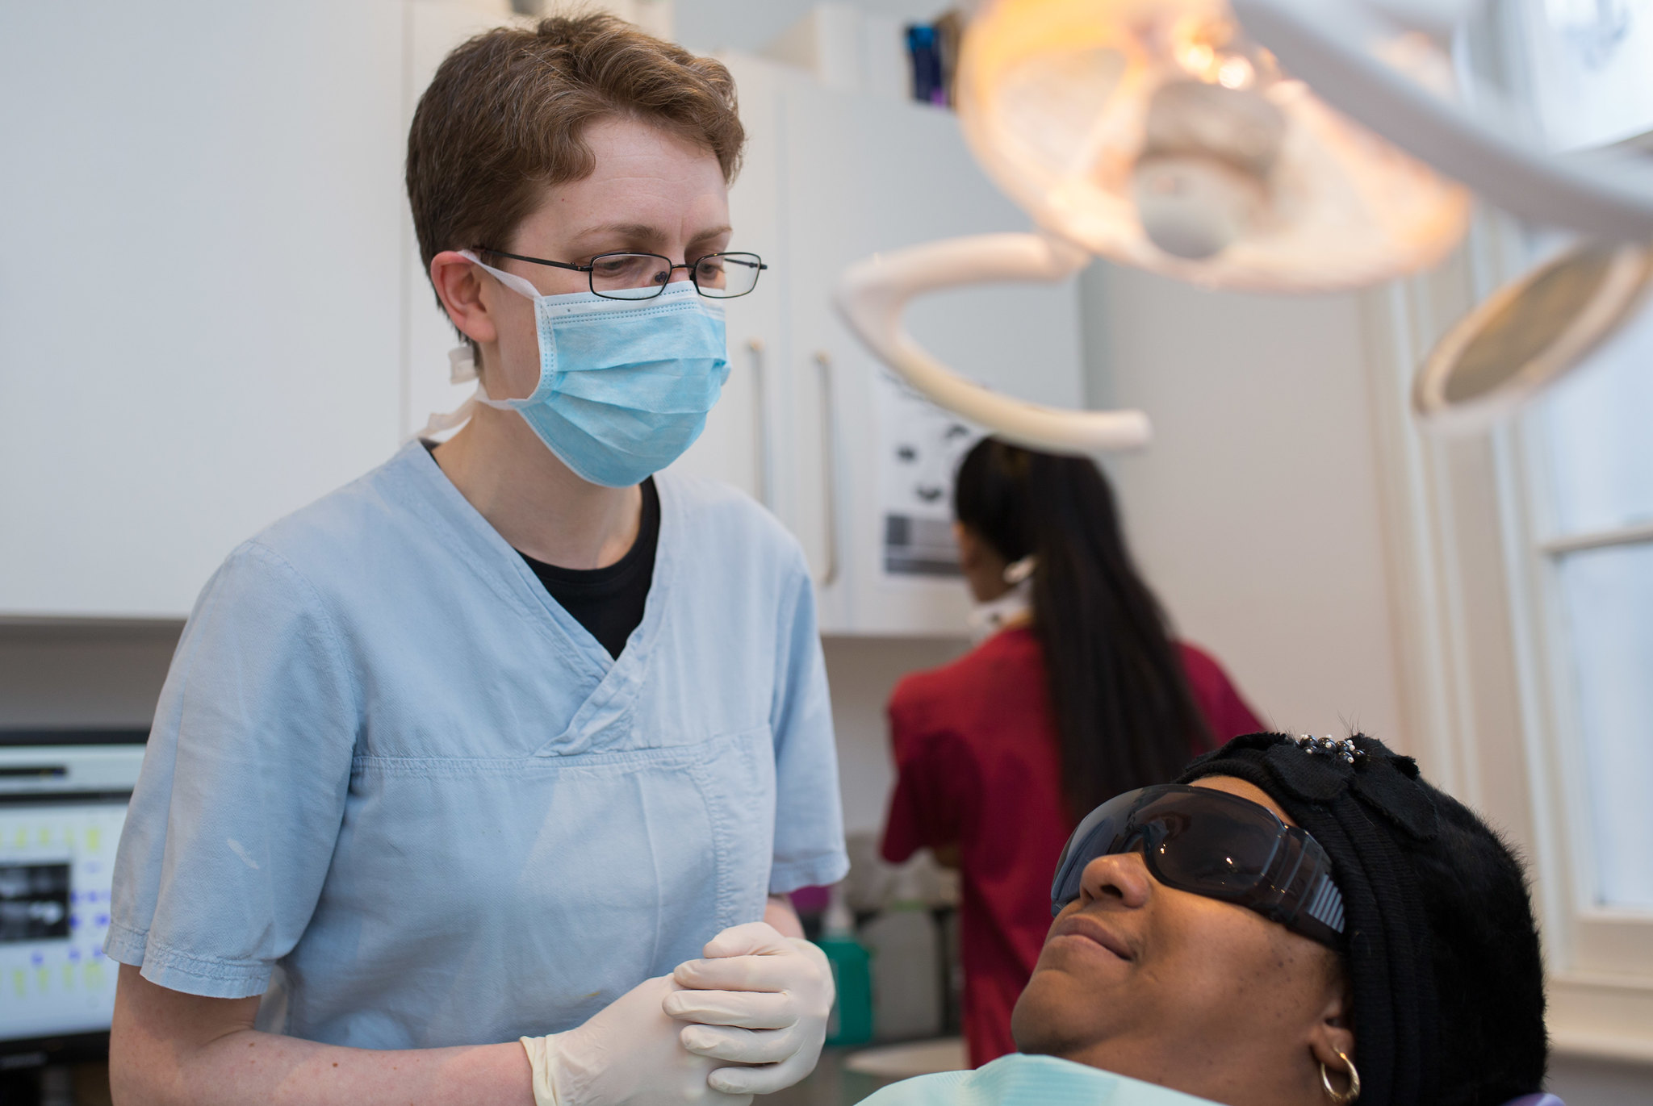
How to access dental care in Rotherham:
Steve Thompson
Notes:
Steve to address the problem of practices are now being told to take on new patients, patients are simply being added to a waiting list they will never get to the top of.

Slide 9
Advice and support for those struggling to access dental care:
Notes:
Stakeholder Update; COVID-19: Resumption of dental services. Provided by Debbie Stovin - Dental Commissioning Manager. January 2022 latest advice
Followed by comments from steve thompson

Slide 10
Stakeholder update - January 2022:
The advice to patients is:
If your teeth and gums are healthy – a check-up, or scale and polish may not be needed for up to 24 months
When you come into the surgery for an appointment, please remember that social distancing remains in place and you will still need to wear a face mask upon entering the practice.
The infection control process for dentistry has not changed with the lifting of COVID19 restrictions – masks and hand hygiene measures are still required.
Please only visit a dental practice if you have an appointment and telephone to book an appointment only if essential – dentists are currently prioritising the vulnerable or those with the most urgent need.
If you develop an urgent dental issue telephone your regular dental practice (or any NHS practice if you don’t have a regular dentist) for advice on what to do next.
If you would like to be able to make an appointment for routine dental care but the practice advises it is not possible to do so, please be understanding of the current situation with regards to the prioritisation of those with urgent needs and be respectful of the clinical decisions taken by the practices.
For out of hours care:
• Toothache should initially be managed with over the counter pain relief until an appointment can be made with your general dental practice. A pharmacist can advise you what is the best pain control to meet your needs.
• Lost fillings, crowns or bridges, broken teeth or braces are not usually deemed to be clinically urgent and patients are advised to contact their local dental practice when they re-open. • Only ring NHS 111 out of hours when your dental needs cannot be met by self-care and cannot wait until your regular practice – if you have one - is open to contact them for advice.
Notes:
Latest stakeholder update, published in January 2022. This the current advice to patients who are trying to book an appointment, and for those who need out of hours care

Slide 11
Planned improvements in dental care access:
“Across Yorkshire and the Humber, there are some localities where patients have had historical and continuing problems accessing NHS dentistry and plans were being developed to increase capacity and look at alternative ways of providing care in these areas.
Unfortunately, the COVID-19 pandemic has temporarily delayed progressing with this. Once the NHS emerges safely from the on-going Covid-19 pandemic, our intention is to continue with this work to improve general access and reduce inequalities, where possible”.
Notes:
Quote from the January 2022 stakeholder update
Followed by comments from steve thompson

Slide 12
Q&A

Slide 13
Upcoming Let’s Talk Event
Let’s Talk… International Cancer Awareness Day
Wednesday 23rd February
11am-12pm
via Zoom

