Slide 1
Let’s Talk… Loneliness

Slide 2
Ground Rules
If we lose you during the session or you have wifi connection issues, please rejoin the meeting, following the same link/meeting ID and password.
To limit background noise, please keep your microphone off unless speaking.
This is an information giving session, rather than a clinical advice session.
Any questions for our guest speakers should be asked at the end of their session, during the Q&A section.
Please use the chat or raise your hand to connect with our guest
……. And lastly ..…..
Please be respectful to each other and each others opinions.
Thank you for attending and we hope you enjoy the session.

Slide 3
Today’s Programme
The Red Cross - Luke Thomas
How the Red Cross tackles Loneliness
About the service
Support available
How to contact the service
Kerry McGrath - Voluntary Action Rotherham
Groups available in Rotherham to support with Loneliness
Let’s B:Friend - Sara Kopecsni
What is the B:friend Service
How it supports people
How to contact the service
Any other Business and January ‘Let’s Talk’ Event Details
Let’s get to know each other...
What is your name and where are you from? (Add it to the chat box)

Slide 4
The Red Cross
Luke Thomas

Slide 5
Q&A

Slide 6
Voluntary Action Rotherham
Kerry McGrath

Slide 8
Volunteering and Social Groups in Rotherham
Kerry McGrath,
Volunteering and Group Support Manager
Voluntary Action Rotherham.

Slide 9
Apply online at VAR
https://www.varotherham.org.uk/i-want-to-volunteer
Just visit Voluntary Action Rotherham’s website and select ‘I want to volunteer’.
Here, you can register and browse our menu of Rotherham volunteer roles. You can apply direct to local organisations and create a unique profile online.

Slide 10
Apply online at VAR:
https://www.varotherham.org.uk/i-want-to-volunteer
Just visit Voluntary Action Rotherham’s website and select ‘I want to volunteer’.
Here, you can register and browse our menu of Rotherham volunteer roles. You can apply direct to local organisations and create a unique profile online.

Slide 11
So much choice!
……..There are currently 68 volunteer roles live on our website!
We think that’s quite a menu!
We like to think there’s something for everyone…

Slide 12
Types of Volunteering
Befriending
Art
Marketing
Events
Conservation
Retail
Admin
I.T.
Teaching
Animals
Music
Fundraising
Gardening
Campaigning

Slide 13
What to expect….
Volunteering is a two way street! It’s important that you and the organisation benefits.
So, what can you expect?......
Named support person
Expenses reimbursed (in most cases)
Policies and procedures in place
Most will provide you with a reference following your placement
Induction
Some organisations offer training

Slide 14
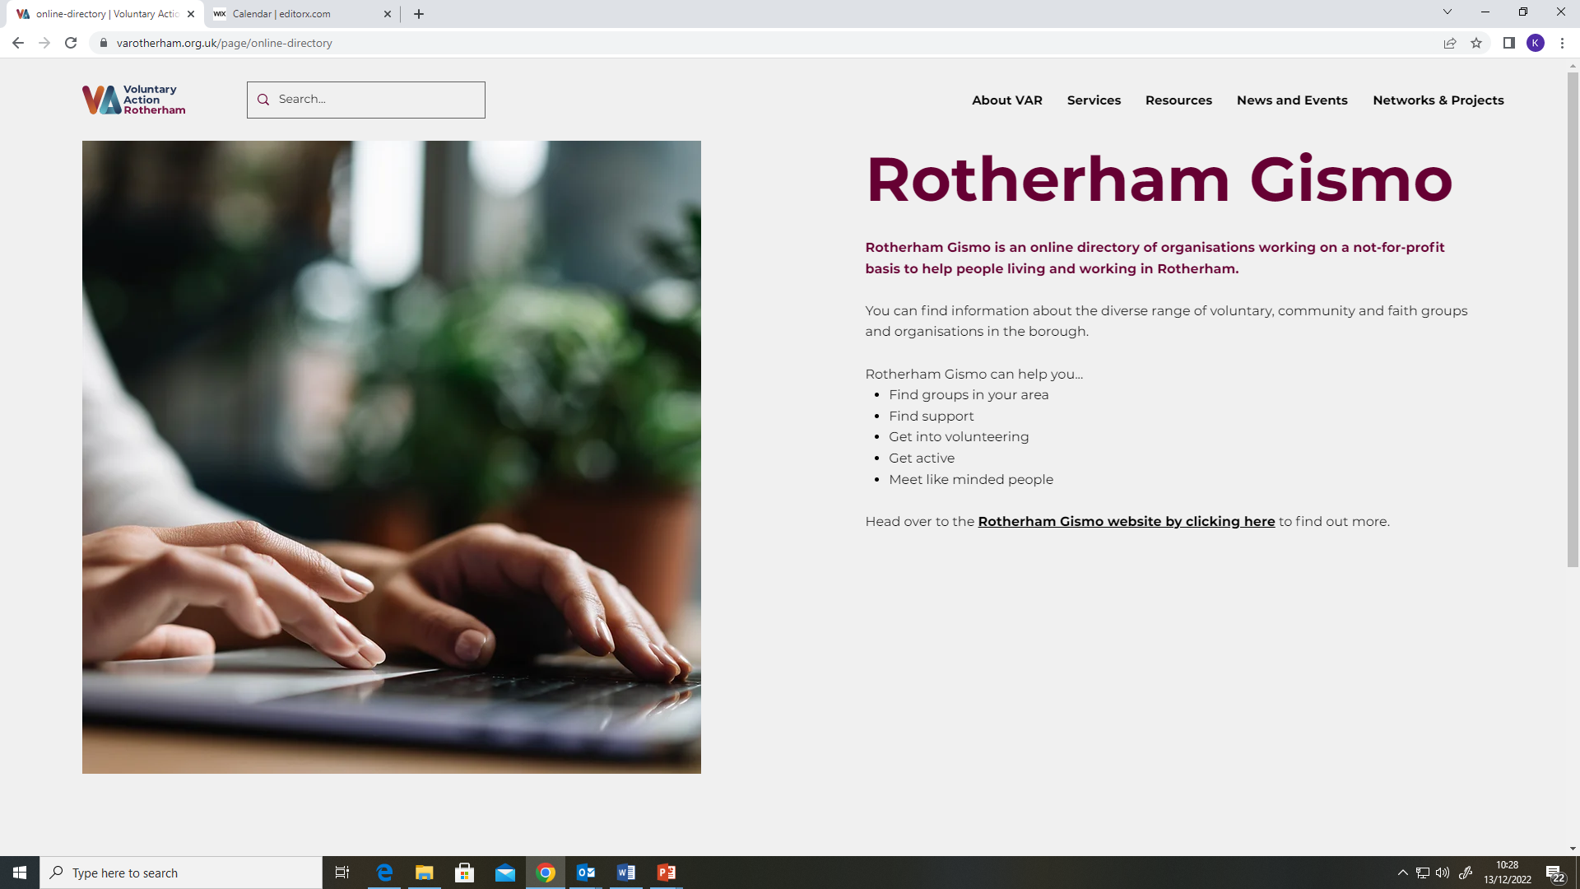
Rotherham GISMO

Slide 15
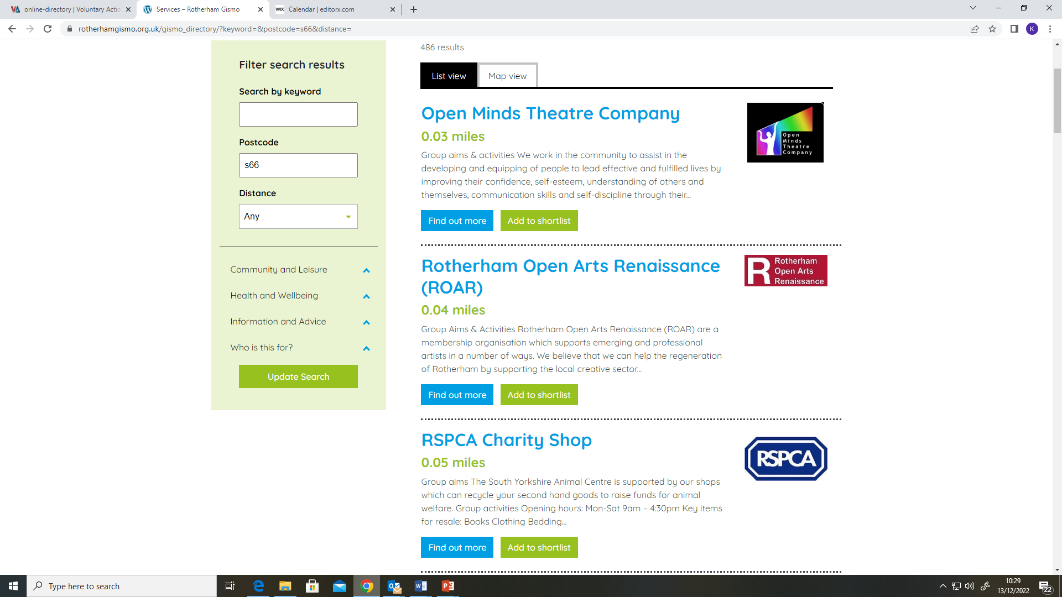
Rotherham GISMO

Slide 16
Contact Details
Contact - Kerry McGrath for more information.
Tel: 07716 919416
kerry.mcgrath@varotherham.org.uk

Slide 17
Q&A

Slide 18
Let’s b: Friend
Sara Kopecsni

Slide 19
Q&A

Slide 20
Feedback survey:
We would really appreciate some feedback from these ‘Let’s Talk’ sessions, so we can constantly improve.
Please take 5 minutes to fill out this short survey. All feedback will be anonymous. Thank you.
Survey link:
https://forms.gle/toE8Nr2mXMKJwPxv7
Notes:
https://forms.gle/toE8Nr2mXMKJwPxv7 - survey link

Slide 21
Upcoming Let’s Talk Event:
‘Let’s Talk… Menopause’
Open to both the public and professionals
Wednesday 18th January :3pm-4pm via Zoom

