Slide 1
Let’s Talk… Eating disorder awareness

Slide 2
Ground Rules
If we lose you during the session or you have wifi connection issues, please rejoin the meeting, following the same link/meeting ID and password.
To limit background noise, please keep your microphone off unless speaking.
This is an information giving session, rather than a clinical advice session.
Any questions for our guest speakers should be asked at the end of their session, during the Q&A section.
Please use the chat or raise your hand to connect with our guest
……. And lastly ..…..
Please be respectful to each other and each others opinions.
Thank you for attending and we hope you enjoy the session.

Slide 3
Today’s Programme
SYEDA - Abbie Twomey
What SYEDA is
About the service
How the group supports people
How to contact the service
Ellern Mede hospital, Moorgate - James Harrison
What is Ellern Mede
What is an eating disorder
Signs and Symptoms
Help and support
Overeating Anonymous
What is Overeating Anonymous
About the service
The support it provides
How to contact the service
Any other Business and February ‘Let’s Talk’ Event Details
Let’s get to know each other...
What is your name and where are you from? (Add it to the chat box)

Slide 4
SYEDA
Abbie Twomey

Slide 5
Eating Disorder Awareness
Healthwatch Rotherham 15.02.23

Slide 6
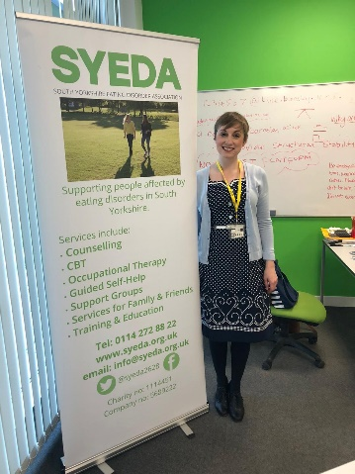
What SYEDA offers
Support for Carers:
Friends and Family support group (monthly)
‘Treading on Eggshells’ course
Counselling for carers
Prevention:
Education
Training
Campaigning
Early Intervention:
Eating difficulties identified and treated early
1:1 Support:
Counselling
Cognitive Behavioural Therapy (CBT-10)
Occupational Therapy
Goal-focused Therapy
Dietetics
Group Support:
Peer Support Group
Consultancy:
Healthcare Organisations
Public Health

Slide 7
What are Eating Disorders?
“Anyone who feels that their relationship with food, body image and/or exercise causes them emotional distress.”
Psychological illness.
Expression of emotional turmoil.
Can be a distraction method or coping strategy for uncomfortable thoughts and feelings.
Often a secretive illness.
Can last a number of years.
Can develop at any age.
A way to manage feelings, and it is also about food

Slide 8
Statistics
Around 1.25 million people in the UK have an ED
ED hospital admissions for boys & young men rose by 128% between 2015-16 – 2020-21
Eating Disorders have the highest mortality rate of any mental illness (in the UK)
4x more CYP were waiting for routine ED treatment by June 2021 than the previous year

Slide 9
Types of Eating Disorder
ARFID
5%
ANOREXIA NERVOSA (AN)
8%
BULIMIA NERVOSA (BN)
18%
BINGE EATING DISORDER (BED)
22%
OSFED
47%

Slide 10
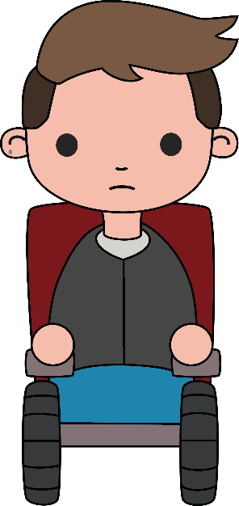
Emotional and Behavioural Signs
Social withdrawal
Change in eating/exercise habits
Distorted body image
Low mood
Difficulty concentrating
Rules around food/exercise
Hiding food
Hiding their body in baggy clothes
Change in behaviour – more irritable/erratic
Visiting toilet after mealtimes

Slide 11
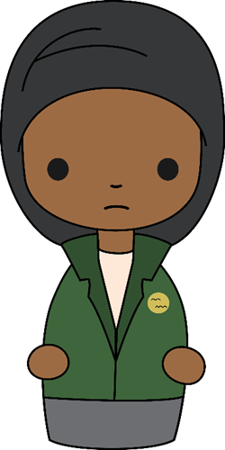
Physical Signs
Low blood pressure
Feeling cold
Difficulty sleeping
Dry skin
Hair loss
Constantly feeling tired/weak
Dizziness
Oedema – swelling in hands/feet/
face
Loss of periods
Lanugo (fine body hair)
Stomach pain – bloating/
constipation

Slide 12
How you can help with recovery
Don’t focus solely on body image or body size
‘I’ve noticed changes in your mood / how much you talk about your friends
Focus on the person's goals and interests
Avoid giving simple solutions
Acknowledge their efforts – no matter how small
Consistency, patience and perseverance
Non-judgemental
Trusting relationship
Notes:
Bearing in mind the points previously on identifying an eating disorder – don’t focus solely on body image or body size. You could say ‘I’ve noticed a difference’ about things other than their size or eating habits, e.g. you’ve noticed changes in their mood / talking about friends less.
This shows you’re concerned about them as a whole, bringing it away from their appearance.
Focus on the person's goals and interests – e.g. using these to motivate them to get better. For example, a client who wants to be in a dance show, but their food restriction means they don’t have enough energy to dance properly.
Avoid giving simple solutions, as obvious as it may seem to us (such as ‘eating more will make you feel better’).
Acknowledge their efforts (even what we might see as small things, like starting to consider eating breakfast). But: avoid saying ‘you look well’ – to someone who is restricting their eating, this can come across as ‘you look fat’ or ‘you’ve put on weight’.
Remember consistency, patience and perseverance. An ED distorts someone’s thoughts, for example this could lead to denial and frustration. We need to show them we’re non-judgemental and are there to support them, not the ED. This might look like regular check-ins, and gradually building a trusting relationship which enables them to open up.
Ultimately – use your knowledge of the client and what they respond well to, and tailor your approach to them. These points aren’t hard and fast rules – the best approach will vary depending on the person. Don’t worry if you think you’ve said the wrong thing, as it’s difficult and you’re not expected to be an expert. The ED can distort well-meaning comments too. Simply showing them you’re there to support them is the most important thing.

Slide 13
Available Support – Young People
Mild-moderate level cases
SYEDA (11+)
If their school has With Me in Mind – WMIM refer to SYEDA
If their school doesn’t work with With Me in Mind – CAMHS / school / parents to refer to SYEDA (on website): https://www.syeda.org.uk/referrals
If 16+ – self-referral (next slide)
Higher level cases
RDASH CEDS service
Professionals can refer by phone or email: https://camhs.rdash.nhs.uk/eating-disorders/referrals/
Up to age 18
Notes:
Available Support – Young People
Mild-moderate level cases
SYEDA (11+)
If their school has With Me in Mind – WMIM refer to SYEDA
If their school doesn’t work with With Me in Mind – CAMHS / school / parents to refer to SYEDA (on website): https://www.syeda.org.uk/referrals
If 16+ – self-referral (next slide)
Self-referral online OR GP can write a letter / can refer them online.
Letters to include:
-Behaviours
-Changes in presentation
-Height & weight
-If SEDS/SEDATT: bloods
Higher level cases
RDASH CEDS service
Professionals can refer by phone or email: https://camhs.rdash.nhs.uk/eating-disorders/referrals/
Up to age 18
RDASH CEDS if underweight / losing weight fast / purging several times a week – i.e. any indication that their physical health needs monitoring.
SYEDA if not this unwell, but their relationship with food / body image / exercise becomes a significant problem.
BUT – not black or white, depends on the case.
Can ring SYEDA or RDASH & discuss.

Slide 14
Available Support – Adults
Mild-moderate level cases
BMI of >17.5 & <5 purges per week:
SYEDA (16+)
Self-referral form on SYEDA website: https://www.syeda.org.uk/referrals
Higher level cases
BMI of <17.5 & >5 purges per week:
SEDS (18+): Sheffield ED Service (Adult ED NHS Community Service across South Yorkshire)
Refer via GP
Notes:
Available Support - Adults
Mild-moderate level cases
BMI of >17.5 & <5 purges per week:
SYEDA (16+)
Self-referral form on SYEDA website: https://www.syeda.org.uk/referrals
Higher level cases
BMI of <17.5 & >5 purges per week:
SEDS (18+): Sheffield ED Service (Adult ED NHS Community Service across South Yorkshire)
Refer via GP

Slide 15
Support Resources
BEAT
Helpline open 365 days
Web Chat
Further Reading:
https://www.beateatingdisorders.org.uk/get-information-and-support/about-eating-disorders/downloads-resources/
www.nationaleatingdisorders.org
https://www.talk-ed.org.uk/
www.anorexiafamily.com
www.NHS.uk/conditions/eating-disorders
www.arfidawarenessuk.org
www.firststepsed.co.uk
Notes:
Beat Helpline (a national ED charity) - open every day of the year (9am–midnight during the week, and 4pm–midnight on weekends and bank holidays)
BEAT also have a 1-1 web chat
BEAT Helpline: https://www.beateatingdisorders.org.uk/get-information-and-support/get-help-for-myself/i-need-support-now/helplines/
BEAT 1-1 web chat: https://www.beateatingdisorders.org.uk/get-information-and-support/get-help-for-myself/i-need-support-now/one-to-one-web-chat/

Slide 16
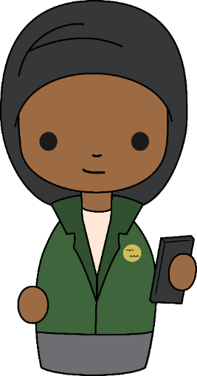
Thank you!
Email: info@syeda.org.uk
Website: www.syeda.org.uk
Address: SYEDA, 26 – 28 Bedford Street, Sheffield, S6 3BT
Tel: 0114 272 8822
@syeda2628
South Yorkshire Eating Disorders Association – SYEDA
Peer support group (14+)
Friends & family support group (14+)
To join: Email info@syeda.org.uk
Registered Charity Number: 1114451

Slide 17
Q&A

Slide 18
Ellern Mede
James Harrison

Slide 19
Q&A

Slide 20
Overeaters Anonymous
https://www.youtube.com/watch?v=x_YMa5Vsv44

Slide 21
Q&A

Slide 22
Other helpful services
Beat Eating Disorders - help@beateatingdisorders.org.uk / 0808 801 0677
Rotherham and Barnsley Mind - 01709 919929
RDaSH Community eating disorder service- 01709 304808
RDaSH Crisis team - 0800 652 9571
Improving Access to Psychological Therapies - 01709 447755
Rotherhive - https://rotherhive.co.uk/eating-disorders/#toggle-id-17

Slide 23
Feedback survey:
We would really appreciate some feedback from these ‘Let’s Talk’ sessions, so we can constantly improve.
Please take 5 minutes to fill out this short survey. All feedback will be anonymous. Thank you.
Survey link:
https://forms.gle/toE8Nr2mXMKJwPxv7
Notes:
https://forms.gle/toE8Nr2mXMKJwPxv7 - survey link

Slide 24
Upcoming Let’s Talk Event:
‘Let’s Talk… Cervical Cancer’
Open to both the public and professionals
Wednesday 15th March :3pm-4pm via Zoom

