Slide 1
Let’s Talk...Dementia Awareness Event

Slide 2
Ground Rules
If we lose you during session or you have wifi connection issues, you have the option to rejoin the session using the same link.
To avoid background noises, please keep your microphones off unless you are speaking.
You can use the chat and raise hand buttons to connect to our guest speakers and they can address your concerns individually.
This is not a clinical presentation, but an information giving session.
Any questions for our guest speakers can be asked at the end of the session.
Please be respectful to each other and each others’ opinions. Thank you

Slide 3
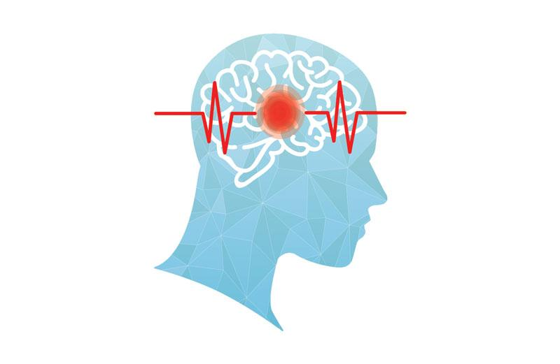
Today’s Programme:
Introductions
Get to know each other
What’s your name and where are you from? (please add in chat box)
Session Overview
Introductions
What is Dementia/Video (5 mins)
Dementia Experience - Martin Cooper’s Story - our Champion Survivor (5 mins)
Myths/Facts - Ask Audience (5 mins)
Alzheimer's Society (5 mins)
Admiral Nurses - Dementia UK (10 mins)
Memory Clinic - RDaSH Team (5-10 mins)
Crossroads (5 mins)
Making Space - Charlotte Byers (5 mins)
Q&A
Other business and upcoming event details

Slide 4
What is a Dementia
Dementia is not a single illness, but a group of symptoms caused by damage to the brain. Dementia is an umbrella term used to describe the symptoms of cognitive impairment. There are different types of dementia which come under this umbrella:-
Alzheimer's Disease (most common).
Lewy Body Dementia (or Dementia with Lewy Bodies) - another very common, yet frequently misdiagnosed or untreated - this causes problems with mood, movement and behaviour.
Vascular Dementia - linked with strokes - it’s progressive, where the person finds it difficult to think and plan.
Frontotemporal Dementia (Picks) - affects language/behaviour - uncommon - affects front/side of the brain - younger people aged 45-65.
Huntington's Disease - no cure - medication such as antidepressants can help some of the symptoms.
Alcohol related brain damage.
Mixed dementia.
Other types.

Slide 5
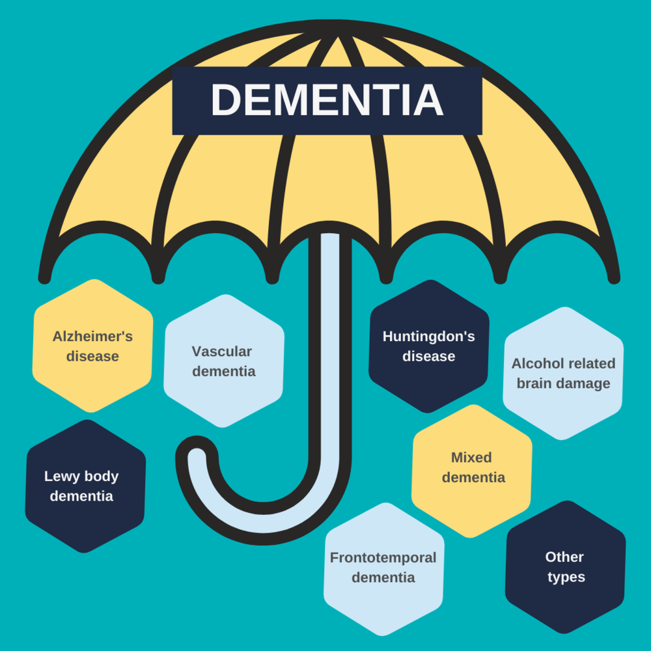

Slide 6
Dementia Video
https://www.youtube.com/watch?v=HobxLbPhrMc

Slide 7
Dementia Experience
Early diagnosis can allow the patient to support themselves by planning their own care accordingly and taking some form of control back, just like my next survivor champion.
Our guest speaker has seen dementia throughout his life, not only has it affected his close family, but himself too. He is a brave man and today he is still standing tall. It’s an honour to have him here with us...

Slide 8
Dementia Champion
Our Star of the Show
Martin Cooper

Slide 9
Myths/Facts - Ask Audience Polls
Alzheimer’s is just another word for dementia
Memory loss is a natural part of aging
Only older people can develop Alzheimer’s disease
Alzheimer’s only affects your mind
Being diagnosed with Alzheimer’s means that you can’t live safely and happily in your own home
It is a progressive condition and has no cure
Dementia is caused by diseases which damage the brain by causing a loss of nerve cells

Slide 10
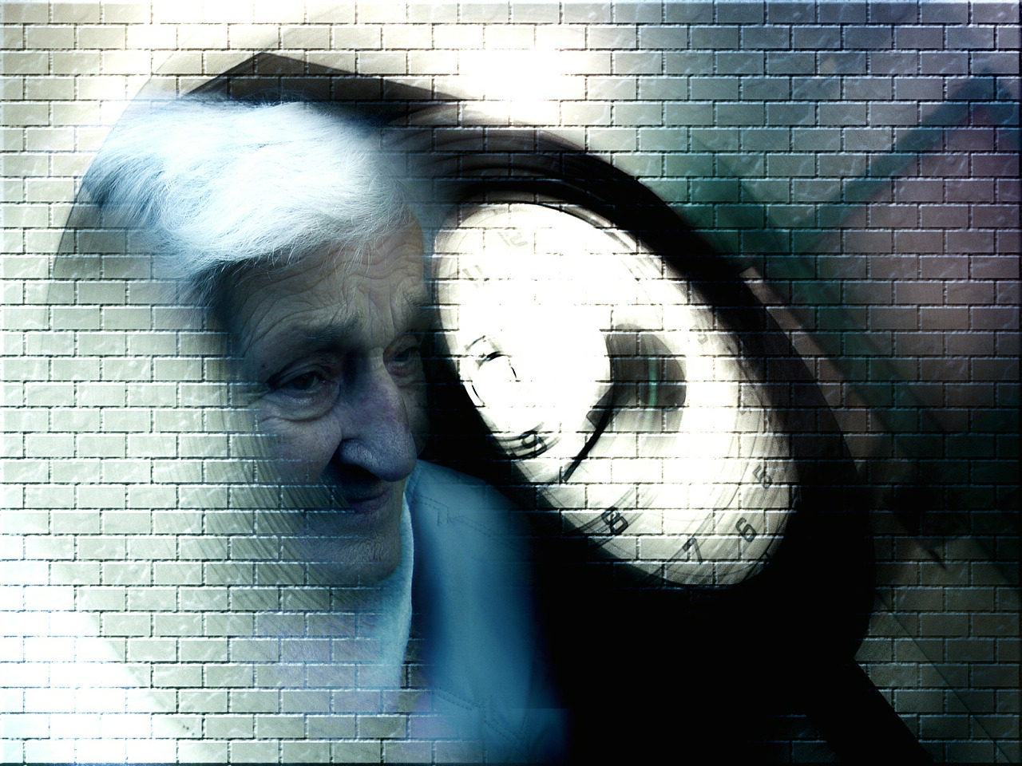
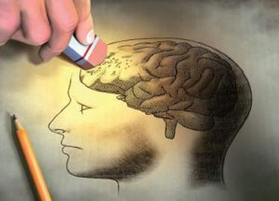
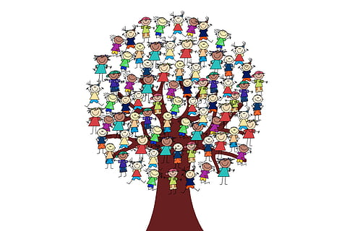
Alzheimer's Society - Georgia

Slide 11
Alzheimer's Society Information
Training
Online and live training.
2-hour course that has been designed specifically for GP practices - aligned with NHS framework.
Training developed by internal training team and delivered by expert trainers.
dementiatraining@alzheimers.org.uk
Singing for the Brain
Developed in the early 2000s.
SftB uses singing to bring people with dementia together in a stimulating, fun, friendly and safe environment.
partnerships.operations@alzheimers.org.uk
Local Support Services
Team of Dementia Connect Local Service Managers/Partnership with Carers Resilience Service.
donacaster@alzheimers.org.uk
01709 580543

Slide 12
Dementia UK - Admiral Nurses Service Update
Liz Tomlinson/Beth Goss
https://www.dementiauk.org/get-support/what-is-an-admiral-nurse-video/
https://www.dementiauk.org/
https://www.dementiauk.org/get-support/closer-to-home/
https://www.dementiauk.org/get-support/dementia-helpline-alzheimers-helpline/
https://www.dementiauk.org/get-support/our-leaflets/
https://www.dementiauk.org/get-support/advice-videos/
Follow us on Twitter - @dementiauk

Slide 13
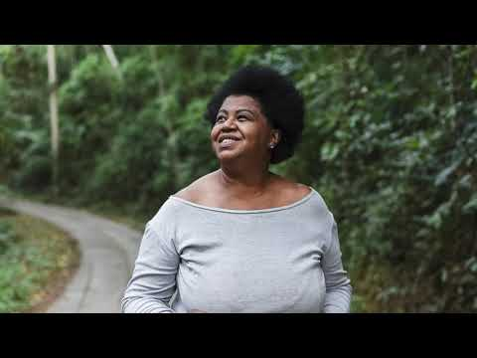
RDASH Memory Clinic - Team Chrissy Taylor, Liz Copley and Kerry Brooker
Memory Clinic & Update of their Services. From Diagnosis to Treatment.
Liz Copley - Consultant Occupational Therapist
Kerri Brooker - RDaSH Community Mental Health Services Manager for the North Rotherham Locality and who oversees all the older peoples mental health services
Chrissy Taylor - Memory Service Manager

Slide 14
Rebecca Bhool- Crossroads
Introduction to Carers Resilience Service

Slide 15
Background
the roots of our service
Dementia is now the greatest health concern for people over 55
The economic cost of dementia is more than cancer, heart disease or stroke
Currently, in Rotherham there are 1688 people on the GP Dementia register compared with a predicted prevalence of 3034
It is estimated that by 2025 the number of people in Rotherham with Dementia will have risen to 4397
The majority of people with dementia are cared for at home by a relative or friend and the average age of a family carer is between 70 years old – a time in their life when they find they may be developing health needs themselves

Slide 16
Carers Resilience Service
We offer those who are looking after someone affected by memory problems and Dementia,
One-to-one support around caring for your loved one
Information, guidance and resources
Education around living well with Dementia
Access to groups and carer befriending services
Benefits checks
Referrals to other services if needed
Liaison with statutory services on your behalf
Complementary therapies
Guidance on keeping safe at home
Access to respite if appropriate
Tel: 01709 464574
Carers.resilience@nhs.net

Slide 17
The Bigger Picture
Outcomes from 1 contact can include…
Reduced feelings of isolation and being overwhelmed
Ease of financial burden
In-home care, easing strain on carer
Prevention of carer breakdown
Prevention of mental health crisis
Respite access
Improvement in social networks & support
Awareness of Rights and exercising rights
Contingency planning
Awareness of support and how to access – widening support circle
Access to specialist support
Practical support
Signposting
Benefits Information
First contact via CRS
Support Groups
Respite Options
Care Act Assessments
Carer
Carers’ Emergency Scheme
Social Support
Mental Health Support

Slide 18
The Bigger Picture – how CRS support surgeries
Awareness of what a carer is
Increased efforts to identify carers
Use of/better use of Carers Registers
Promotion of Carer Champions
Point of contact for signposting
Better outcomes for patients
Education for surgery staff
Meets contractual obligations
Surgery Staff
Consistency across GP surgeries
Sharing good practice
Promotes Carer Friendly culture
Eases some burden on surgery resources

Slide 19
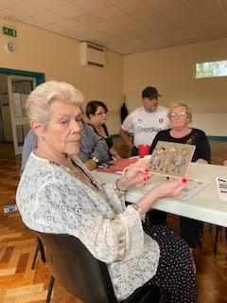
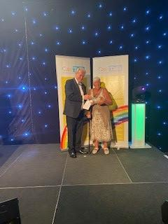
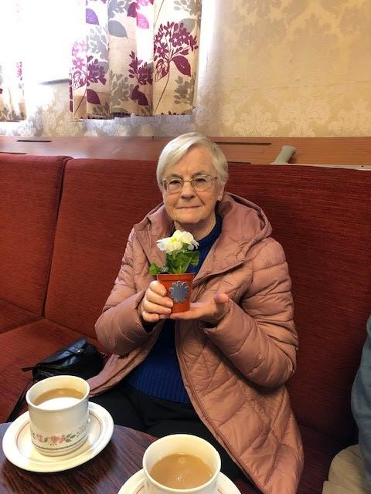
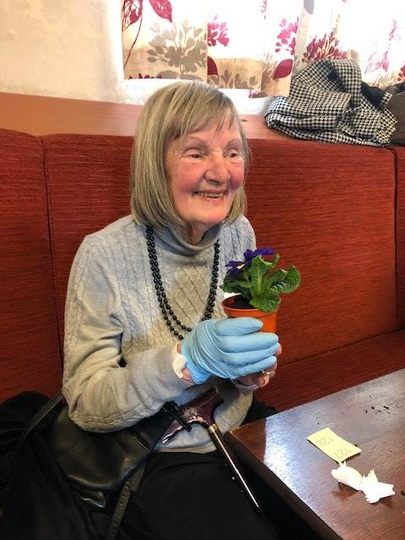
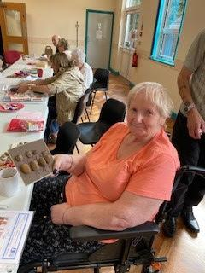
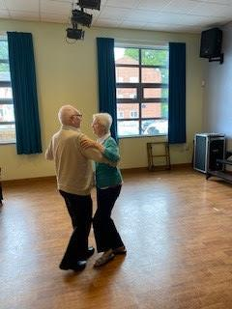
Making Space - Charlotte Byers (Dementia Advisor)
Update of Service
Dementia Cafes
Disc - Dementia Information Support for Carers
https://www.facebook.com/rotherhamcarers
https://makingspace.co.uk/rotherham-dementia-carer

Slide 20
Q&A

Slide 21
Any other business/ Next event details:
Next event:
Let’s Talk…COPD DAY/TB Event
Wednesday 24 November 21, 11am-12 noon
On Zoom

